Slide 1

Movement and Control of
Biomimetic Humanoid Robots
Dissertation Defense
Ben P. Bolen
Advisor: M. Anthony Hunt, Ph.D.
Agile & Adaptive Robotics Laboratory · Portland State University · November 2026
Notes:
Good morning. Committee members, thank you for reading the dissertation. Today: four objectives - characterize the actuator, validate and correct the joint torque prediction, consolidate the afferent literature, and build the verified control toolchain - connecting one actuator to a walking, neurally controlled robot. Anticipated question: why does the title say 'movement and control' rather than a single topic? Answer: the dissertation spans actuator to controller, and the title follows the program it serves (Ch. 1, sec. 1.2).

Slide 2
ROADMAP
Four objectives connect one actuator to a robot that walks under neural control
01
02
03
04
Characterize
BPA isometric force
Validate knee
torque prediction
Consolidate the
afferent literature
Build tools for
neural control
Festo 10 and 20 mm BPAs across resting length,
contraction, and pressure; improved maximum-force
and normalized force models vs. existing models
(Ch. 3)
Pinned and biomimetic four-bar knees; correction
terms for length offset, series compliance, and
wrapping; envelopes vs. human torque
(Ch. 4)
Audit and curate the Ia, Ib, and group II afferent
record into the Sensory Afferent Database;
AI-assisted triage for expansion
(Ch. 5)
OpenSim to MuJoCo conversion; SNS-Toolbox two-level
spinal CPG with proprioceptive and heel/toe contact
feedback; staged tuning and verification
(Ch. 6-7)
537 tests · dimensionless
force surface
redesign meets / exceeds
human targets
943-paper audited corpus
verified cross-engine
toolchain
Dissertation Ch. 1 §1.3 (research objectives); outcomes in Ch. 3-7
2
Notes:
One sentence per objective, mirroring Ch. 1 sec 1.3: objective 1 (Ch. 3) is published as Bolen et al. 2026, Actuators; objective 2 (Ch. 4) stands on the isometric torque manuscript; objective 3 (Ch. 5) is the Sensory Afferent Database; objective 4 (Ch. 6-7) is the simulation toolchain with its cross-engine verification. Anticipated question: which objectives are experimental? Answer: objectives 1-2 are hardware experiments on the jig and the knee stands; objective 3 is literature curation; objective 4 is simulation tooling - the same split the introduction states (first two gaps addressed experimentally, the fourth resolved by the database, the third closed by the tools).

Slide 3

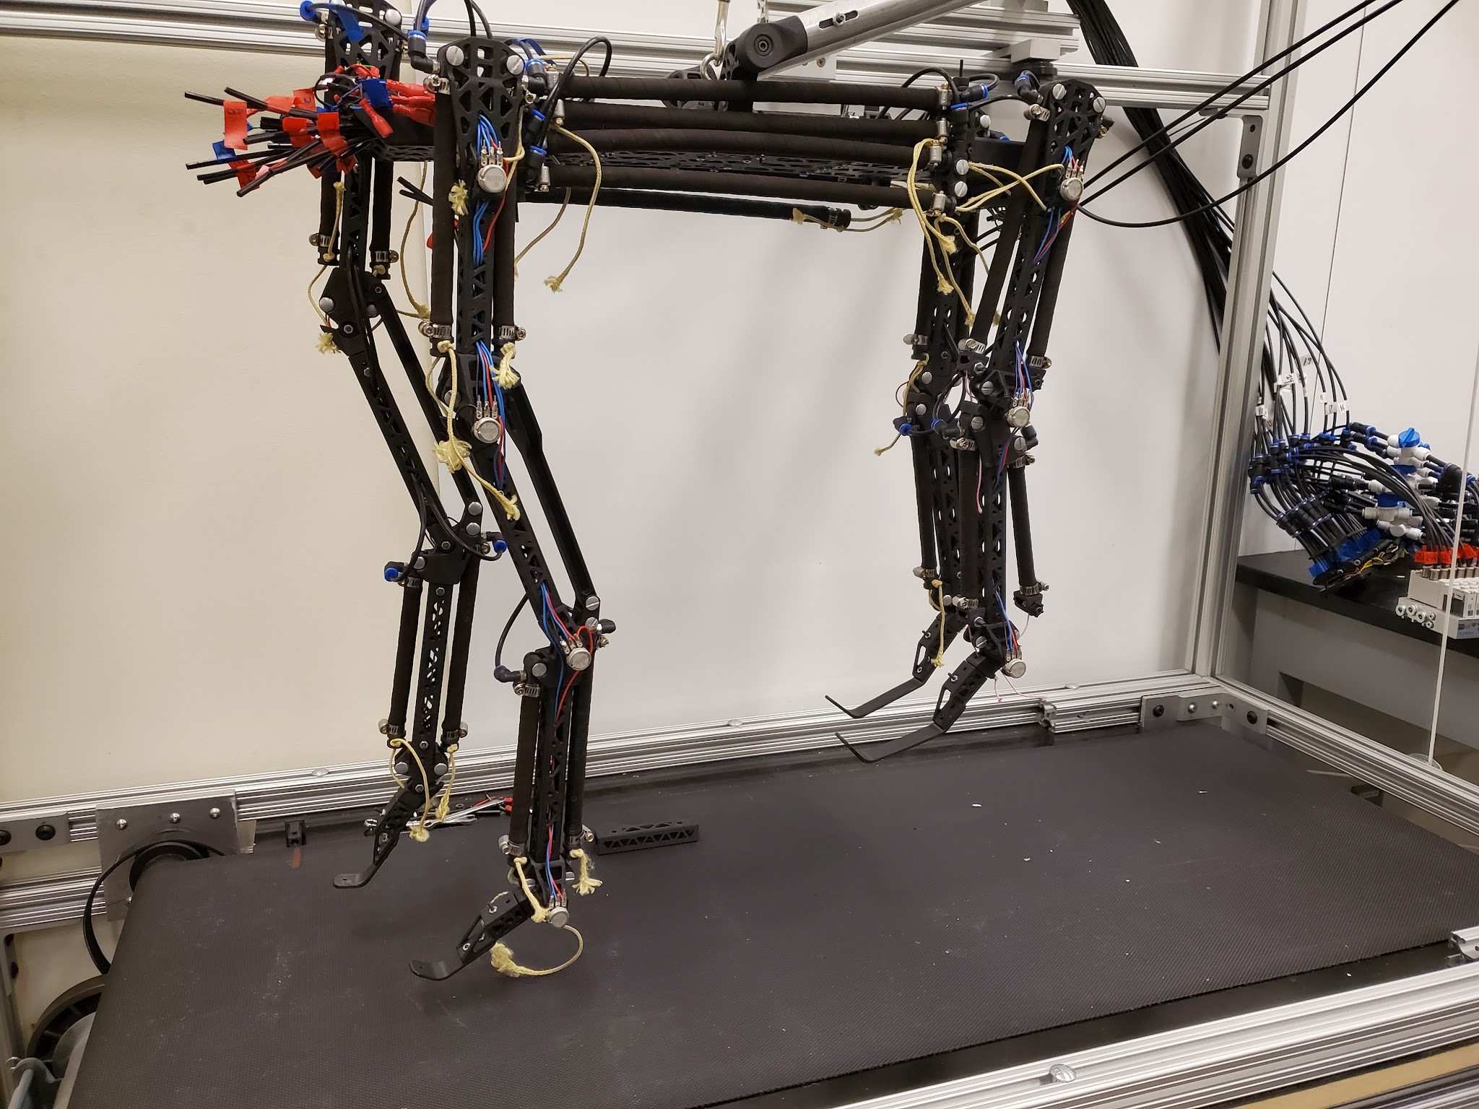
THE PROJECT
A humanoid robot from the trunk down: human-like body plan, synthetic nervous system
GUIDING HYPOTHESIS
human-like muscle numbers, architecture, routing + human-like torque capability, controlled by a biologically grounded neural architecture → biomimetic movement
BUILT ON
my master's work: Gait2392-matched kinematics, muscle routing tools · Morrow: optimized attachments · Steele: biomimetic 4-bar knee · Scharzenberger: BPA quadruped
THIS DISSERTATION
the quantitative basis: characterize the actuator, correct the joint model against experiment, compare with human torque, consolidate the afferent data, and define the control path
converted leg model, 92 muscle paths
AARL quadruped: BPA actuators + SNS, already on a treadmill
Dissertation Ch. 1 §1.2; Bolen & Hunt 2019; Morrow et al. 2020; Steele 2018; Scharzenberger et al. 2019
3
Notes:
Ground the committee: this dissertation is the actuator-and-joint foundation of the AARL humanoid program (Ch. 1, sec. 1.2). The converted model shown carries all 92 muscle-tendon actuators (Ch. 6). Anticipated question: what did the master's work establish? Answer: Gait2392-matched kinematics and muscle-routing tools - and the finding that transplanting human attachments onto a BPA robot does not reproduce human torque profiles, which motivates the placement optimization completed in Ch. 4.

Slide 4
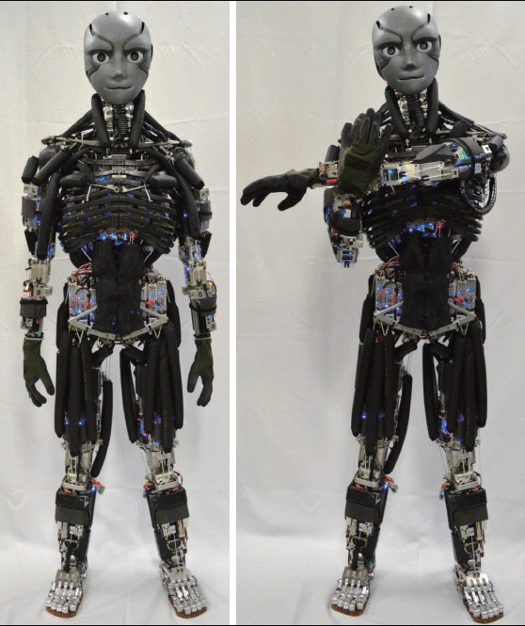
WHY BIOMIMETIC ROBOTS
Robots run neuromechanical experiments that are impossible in living subjects
Biology
anatomy · architecture · afferents
– Remove one muscle from the system
– Block one sensory feedback pathway
– Stimulate a named neural pathway
design principles
test hypotheses
– Identical copies - no individual variance
– Faster, cheaper, ethical vs. human studies
Robot
actuators · routing · controller
Loss-of-function and stimulation experiments
are the point of the platform.
human-mimetic musculoskeletal humanoid
Dissertation Ch. 1 §1.1; Ijspeert 2020; Shin et al. 2018; photo: Asano et al. 2016, Humanoids
4
Notes:
The biology professor on the committee will recognize this loop: model, perturb, understand. The experiments listed are the ones the introduction names (Ch. 1, sec. 1.1). Anticipated question: why physical robots rather than simulation-only studies? Answer: musculoskeletal humanoids and limb systems support experiments on internal force transmission and hardware realities that simulation assumes away; the two are complementary.

Slide 5
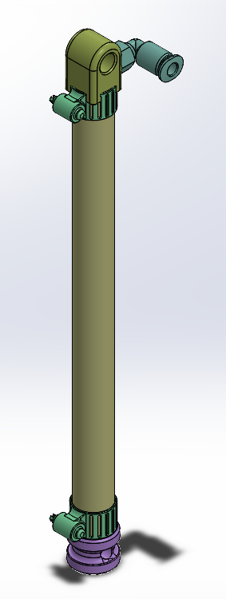
THE ACTUATOR
Braided pneumatic actuators: muscle-like strengths, and three modeling headaches
WHY WE USE THEM
WHY THEY ARE HARD
+ High force-to-weight, low mass
– Maximum force occurs AT resting length
+ Intrinsic compliance - safe, spring-like
– Contraction limited (max ≈ ε₆₂₀)
+ Tension-only, like biological muscle
– F highly nonlinear in l₀, P, ε
+ Force-length curve qualitatively muscle-like
– Manufacturer tool mis-predicts short BPAs
Designing a biomimetic robot around BPAs needs quantitative, predictive models:
actuator force → joint torque → comparison with human capability
Festo DMSP-10/20
Dissertation Ch. 1 §1.1 + Ch. 2; Hunt et al. 2017; Sárosi et al. 2012-2017; Martens & Boblan 2017; Festo DMSP datasheets
5
Notes:
Sets up gap 1. Force peaks AT resting length - unlike a biological muscle whose optimum is mid-range (Ch. 3, biomimetic-analogy discussion). Anticipated question: why BPAs rather than electric actuators? Answer: low mass, high force-to-weight, intrinsic compliance, tension-only operation, and a qualitatively muscle-like force-length curve (Ch. 1, sec. 1.1) - the costs are the modeling issues on the right, which Ch. 3 quantifies.

Slide 6
PROBLEM STATEMENT
Four gaps stood between the existing design and a robot that walks under neural control
GAP 1
No actuator force model valid at arbitrary resting length
Festo tool over-predicts short BPAs; published models fit a single length each
GAP 2
No quantified correction for torque lost through brackets, tendons, and wrapping
optimized biomimetic routing never validated against human isometric torque
GAP 3
No closed-loop pipeline from the robot model to a biologically realistic controller
two-level CPG ingredients existed, never assembled for a BPA biped with human-like routing
GAP 4
No consolidated resource for the afferent data a controller requires
Ia, Ib, and group II properties scattered across hundreds of primary papers and reviews
Objectives 1-2 address gaps 1-2 experimentally · the SADb resolves gap 4 · the tools close gap 3
Dissertation Ch. 1 §1.1 (summary paragraph) + §1.3
6
Notes:
The four gaps are the introduction's own summary (Ch. 1, sec. 1.1, closing paragraph). Anticipated question: why is gap 4 in the literature rather than in methods? Answer: the physiological properties of the Ia, Ib, and group II afferents that should inform feedback design are scattered across hundreds of primary papers and reviews with no structured resource - the dissertation resolves it by consolidation (the SADb) and closes gap 3 with the tools, while gaps 1-2 are addressed experimentally.

Slide 7

CH. 3 · MUSCLES
A custom jig measured isometric force across resting length, pressure, and contraction
DIAMETERS
10 mm and 20 mm Festo DMSP
RESTING LENGTHS
112-518 mm (10 mm) · 300-509 mm (20 mm)
PRESSURE
up to P₆₂₀ = 620 kPa supply
DATA
537 force-pressure-contraction pairs (321 + 216)
INSTRUMENTATION
S-type load cells + HX711 · MPX5700 pressure · Arduino → MATLAB
Dissertation Ch. 3 §3.1 (test jig); Bolen, Elzein, Pang, and Hunt 2026, Actuators
7
Notes:
Hardware slide - one breath. The point: wide l0 range, both diameters, 537 pairs. Anticipated question: how is contraction set? Answer: the distance between the jig crossmembers is controlled to obtain each contraction, then the muscle is inflated and the contractile force recorded at the pressure-contraction pairs (Ch. 3, sec. 3.1).

Slide 8


CH. 3 · MUSCLES
Maximum isometric force depends on resting length - a previously unreported characteristic
φ 10 mm: F₆₂₀ vs l₀
φ 20 mm: F₆₂₀ vs l₀
solid: our arctan fit (data-driven) · dashed: Festo tool - predicts force INCREASING as l₀ shrinks
Dissertation Ch. 3 §3.2 (F₆₂₀ vs l₀); Bolen et al. 2026, Actuators, Figs. 2-3
8
Notes:
The discovery slide. Festo's own tool predicts the OPPOSITE trend - force rising as length shrinks. Anticipated question: is the length effect truly unreported? Answer: the chapter states it is a previously unreported characteristic of these artificial muscles; the Festo tool does predict a length dependence, but with the wrong sign (force increasing at shorter lengths).

Slide 9
CH. 3 · MUSCLES
Two coefficients per diameter capture the resting-length effect
LIMITS BEHAVE
l₀ → ∞: 470 N (10 mm) vs Festo 490 N
within Festo's stated 10% manufacturing tolerance (20 mm: 1460 vs 1570 N)
THE OFFSET IS PHYSICAL
7.5 mm / 13 mm = length at which the end caps contact each other in the CAD model - no contractile stroke remains
As l₀ → 0, measured force → 0.
Dissertation Ch. 3 §§3.1-3.2 (equations + coefficient table); Bolen et al. 2026, Actuators, Eqs. 4-6; fit: nonlinear least squares, least-absolute-residual
9
Notes:
Math committee: arctan form, bounded asymptote, physical offset from end-cap contact in CAD. Anticipated question: why an arctan? Answer: the measured F620 vs l0 saturates, and the arctan is the bounded curve that matches it; the l0 offsets (7.5 mm and 13 mm) are the lengths at which solid modeling shows the end caps contacting, where no contractile stroke remains.

Slide 10
CH. 3 · MUSCLES
At short resting lengths the manufacturer's tool mis-predicts force by 42%
WHY THE TOOL FAILS SHORT
Ideal cylindrical models ignore end effects; the clamped ends force steep stress gradients.
The end-effect zone has roughly fixed length - so as l₀ shrinks, it dominates.
Measured force → 0 as l₀ → 0. The Festo tool instead predicts exponential growth.
“Researchers using BPA resting lengths under 300 mm should take note.”
error: 4.5% (ours) vs 42.1% (Festo)
Dissertation Ch. 3 §3.3 (discussion: effects of resting length); example: φ10 mm, l₀ = 112 mm, 620 kPa
10
Notes:
The design-relevant failure: anyone specifying BPAs under 300 mm gets burned by the tool. Anticipated question: is 42% within Festo's tolerance? Answer: no - Festo states roughly 10% manufacturing variability; 42.1% is roughly four times that, at a length a knee design actually uses, and the error direction (over-prediction) is the unsafe one for design.

Slide 11


CH. 3 · MUSCLES
All 537 measurements collapse onto one dimensionless force surface
F*(ε*, P*) - φ10 mm, pressure isoclines
F*(ε*, P*) - φ20 mm
Dissertation Ch. 3 §3.2 (normalized surface); ε* = ε/ε₆₂₀, P* = P/620 kPa
11
Notes:
Normalization by each muscle's own F620 and eps620 is what makes one surface fit all lengths. Anticipated question: does eps620 need to be measured per actuator? Answer: yes - the chapter found no conclusive relationship between eps620 and l0 (linear fit adj. R2 = 0.4124), so each muscle's maximum contraction is recorded for use on the robot.

Slide 12
CH. 3 · MUSCLES
Three coefficients per diameter: force predicted out-of-sample to a few percent
adj. R² (fit)
adj. R² (validation)
max err (fit)
max err (val.)
φ 10 mm
0.9998
0.9994
10.3%
10.6%
φ 20 mm
0.992
0.9943
6.8%
5.7%
RMSE (normalized): 0.005 (10 mm) · 0.023 (20 mm)
The whole actuator model a designer needs:
F* (3 coefficients, per diameter) × F₆₂₀(l₀) (2 coefficients, per diameter)
Dissertation Ch. 3 §3.2 (F* coefficient + goodness-of-fit table); 80/20 train/validation split
12
Notes:
Stress: validation is 20% held out, and max error under ~11% everywhere - at ANY length. Anticipated question: what do the max errors mean? Answer: on the held-out set the 10 mm surface reaches a 10.6% maximum residual (RMSE 0.0245 normalized) and the 20 mm reaches 5.7% (RMSE 0.0231); adjusted R2 stays at 0.9994 and 0.9943 respectively.

Slide 13
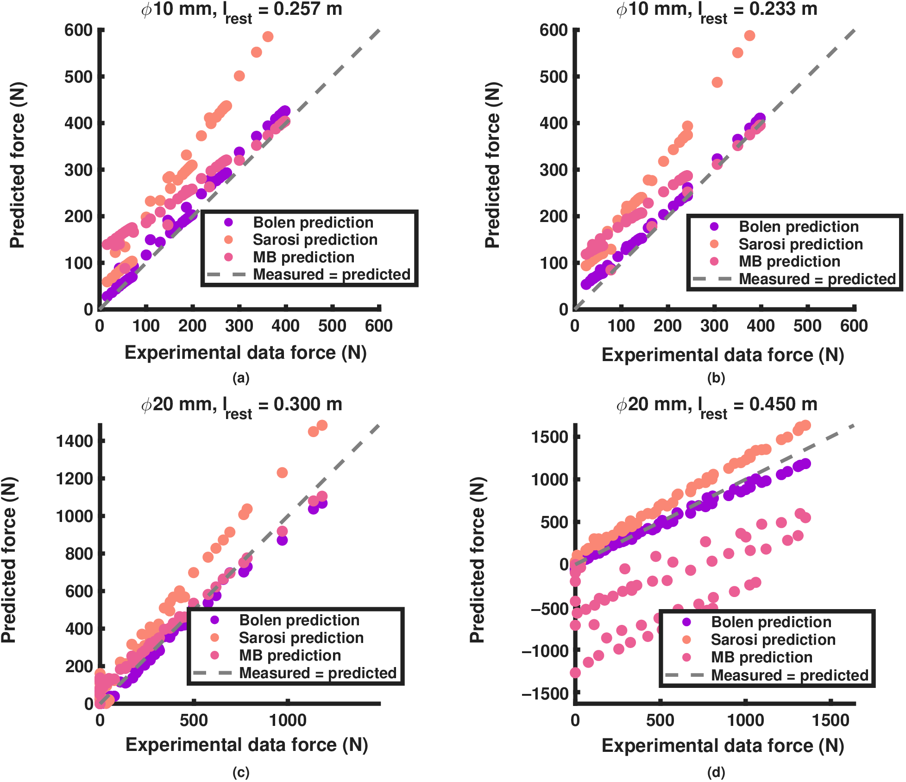
CH. 3 · MUSCLES
Lowest error of the compared models at every diameter and length tested
RMSE (N) at matched conditions
l₀
Bolen
Sárosi
M&B
10 mm, 257 mm
22.9
143.8
73.8
10 mm, 233 mm
16.8
132.7
62.6
20 mm, 300 mm
35.6
132.1
72.8
20 mm, 450 mm
67.6
177.7
862.1
Normalization travels: one fit per diameter works across lengths,
while fixed-parameter models fail when moved off their fit length.
measured vs predicted; y = x is perfect fit
Dissertation Ch. 3 §3.3 (comparison with published BPA models); Bolen et al. 2026, Actuators, Fig. 5 + Table 3
13
Notes:
Sarosi params come from specific lengths - extrapolation is where they fail. Martens is geometry-sensitive. Anticipated question: why does Martens and Boblan blow up at 450 mm? Answer: geometric sensitivity - the chapter shows its F_PE dD/DL term grows dominant off its fitted geometry, to the point of predicting negative force at 20 mm, 450 mm.

Slide 14
CH. 3 → CH. 4
The force model is two cheap maps - built to sit inside a real-time controller
MAP 1
MAP 2
F₆₂₀(l₀)
resting length → max force
F*(ε*, P*)
strain, pressure → fraction
Closed form or lookup table; evaluated per timestep in the robot model.
Next: multiply by geometry (moment arm) → joint torque. Does it survive contact with the joint?
Dissertation Ch. 3 §3.3 (implications for real-time control and simulation); dynamics complement: Elzein et al. 2025
14
Notes:
Static map = feedforward actuator model inside the controller (lookup table). Valve-airflow dynamics are the Elzein layer. Anticipated question: can a static isometric map really support control? Answer: the chapter cites Martens and Boblan - BPA dynamics are dominated by valve air dynamics and mass flow, so the static force characteristic is the crucial piece for torque control accuracy; the model is computationally inexpensive online and suits lookup tables.

Slide 15

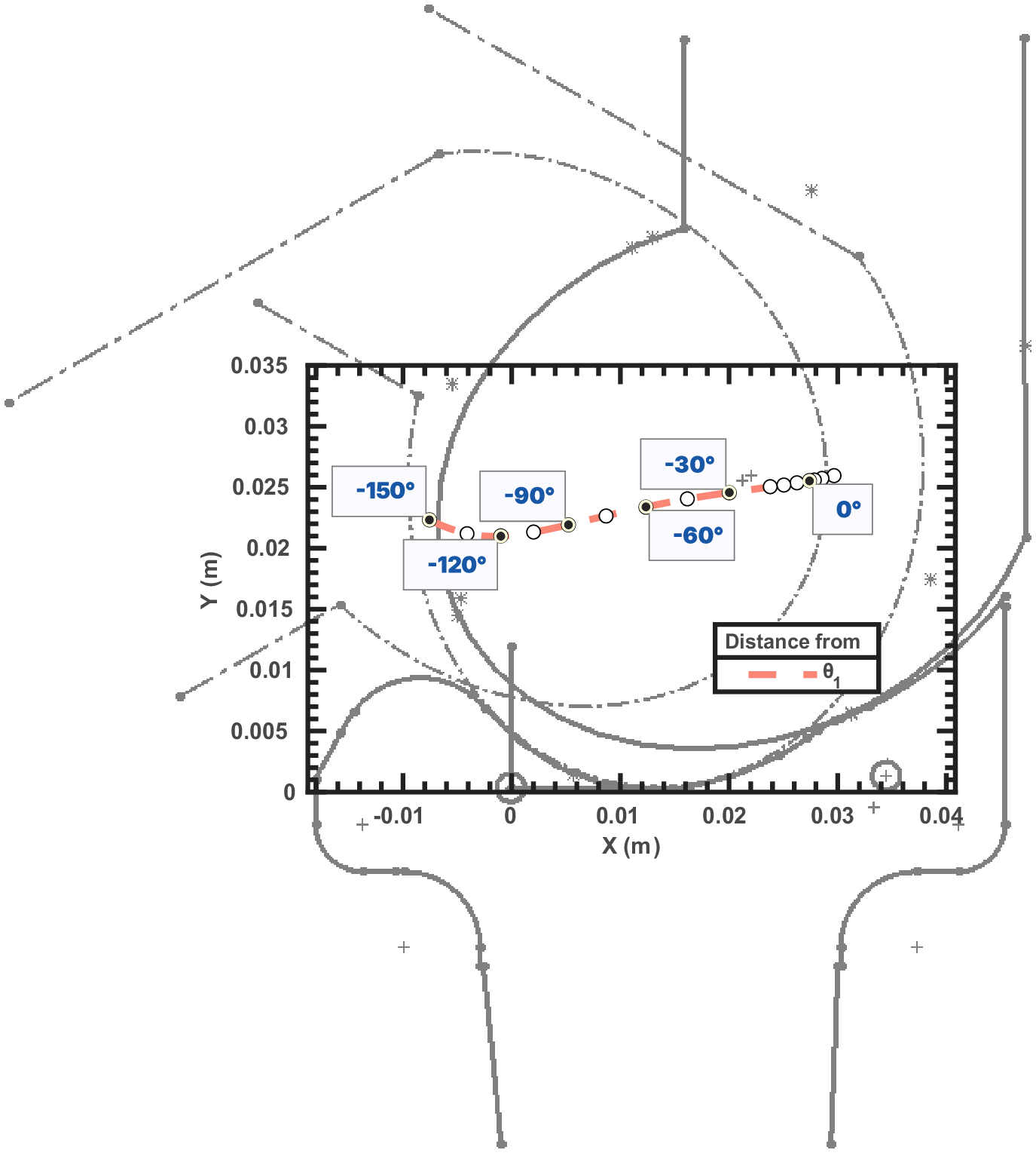
CH. 4 · ISOMETRIC KNEE TORQUE
Two test stands: a pinned knee exposes the losses; the biomimetic four-bar validates them
FOUR-BAR KNEE
Crossed links give a migrating instantaneous center of rotation - posterior and distal with flexion, like the human knee.
Torque depends on the ICR: getting it right matters for both prediction and experiment.
Both stands tested with ⌀10 mm BPAs; the biomimetic knee also with a ⌀20 mm flexor, its routes mirrored about Z.
test stands: CAD (A) · labeled apparatus (B) · torque testing (C)
biomimetic knee: migrating ICR
Dissertation Ch. 4 (Isometric Knee Torque), robot leg model and test stands; four-bar knee: Steele et al. 2018
15
Notes:
Bone geometry from scans of a 6 ft (1.83 m) person. Both joints share the same center of rotation in the femur frame at 0 deg, and the knee axis is co-axial with gravity so measurements stay isometric. Q: why two stands? A: the pinned stand isolates one DoF for identification; the four-bar validates transfer to the moving-ICR joint the robot uses.

Slide 16

CH. 4 · HYBRID METHOD
The hybrid method shows the error is kinematic, not force
HYBRID TORQUE
M = r × F with measured muscle length and moment arm, model force
Hybrid ≈ measured ✓
the validated force model is not the problem
Rigid prediction ≠ measured ✗
the kinematics (Lₘ, rₖ) are what the model gets wrong
yellow = hybrid; it sits on the blue measured dots where they agree - that agreement is the result
blue = measured · black dashed = original model · dashed red = improved BPA characterization
Ch. 4, Fig. FlxPin_group A-B (pre-optimized pinned flexor); manuscript bolen_isometric_2025 (in prep.)
16
Notes:
Yellow = hybrid (measured Lm and rk + model force). It tracks measurement, so the validated force model is not the problem; the kinematics were. Q: is the hybrid a fit? A: no; it substitutes measured Lm and rk into the same M = rF physics, isolating which model term was wrong.

Slide 17
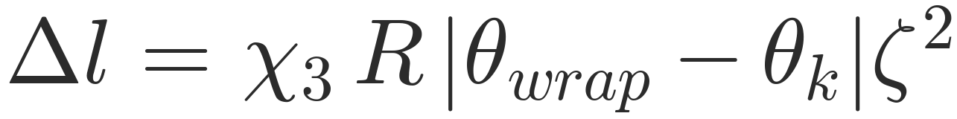

CH. 4 · IMPROVED MODEL
Three physical effects close the gap: length offset, series compliance, wrap loss
χ₀ · constant length offset
χ₁, χ₂ · bracket compliance
χ₃ · wrapping loss (θₖ ≤ θ_wrap)
measured shorter than predicted - even at ε = 1, F = 0
compliance projected on the force direction û · tendon in series
arc length lost to the bend · grows with ζ = 1 − ε*
bracket frames, pinned configurations (A, B)
Ch. 4, improved torque model (Eqs. lm, K_br, delta-l); bracket frames: Fig. bktFrame; two-bracket projection: Fig. xiProjection
17
Notes:
chi1/chi2 are EFFECTIVE system stiffness terms (bracket, fixtures, winch, and tendon lumped together), not literal beam stiffness; every stiffness value quoted is an optimizer output. Q: why not model the bracket by FEA? A: printed anisotropic parts, braided sleeve, and construction-dependent tendon stiffness are unmeasured; the lumped terms are identified from the measured torque itself. Moved off-slide: chi0 - measured muscle length is consistently shorter than predicted at every angle, including at ε = 1, F = 0; that is a constant offset. chi1/chi2 - Hooke law in bracket principal directions; compliance projected on the force direction û; artificial tendon added in series. chi3 - a BPA bent over the joint loses usable arc length: the wall on the inside of the bend carries less tension; loss grows with the complement of strain, ζ = 1 − ε*. All three terms are solved together by nonlinear force balance: Fₘₐₓ · F*(ε*(δ), P*) − kₑₔ δ = 0 → δ (bracketed fzero), then length, path, moment arm, and torque are recomputed at the deflected geometry.

Slide 18
CH. 4 · IDENTIFICATION PROTOCOL
Terms identified by multiobjective optimization, judged on held-out tests
4 pinned-flexor tests
(48.5 / 45.7 / 40.6-tendon / 41.0 cm)
cross-validate:
2 train / 2 hold per fold
Pareto front
{RMSE, FVU, max res.}
pick: held-out fit +
cross-configuration
flexor fit solves (χ₀, χ₁, χ₂) with TWO brackets
(origin + insertion), shared stiffness pair
extensor refit LOCKS (χ₁, χ₂) to the flexor-identified values,
solves only (χ₀, χ₃); χ₀ allowed negative
Bounds of record (Appendix C)
flexor: χ₀ ∈ [0, 20] mm · χ₁ ∈ [3×10⁴, 10⁶] N/m · χ₂ ∈ [5×10³, 2×10⁴] N/m
extensor: χ₀ ∈ [−20, +5] mm · χ₃ ∈ [0, 1] · (χ₁, χ₂) = flexor pair, never searched
Ch. 4, identification (gamultiobj / NSGA-II, Deb 2002); bounds: Appendix C, Table C.3 (app_opt_bounds)
18
Notes:
gamultiobj: flexor two-bracket fit evolves 150 for up to 600 generations, extensor refit 50 for 150; parameters searched normalized (cm, log stiffness). The encoder-corrected 47.9 cm test was not used in the two-bracket identification at all. Q: why hold tests out? A: the pinned-flexor data admit a family of stiffness pairs of comparable fit, so the adopted set is selected by held-out prediction, not residual minimization.

Slide 19

CH. 4 · PINNED FLEXOR
With corrections, prediction tracks measurement - including the dip at small angles
THE MISSING DIP
The rigid model completely missed the torque reduction at small flexion angles.
The corrected model captures it.
VALIDATION
45.7 cm BPA: different length, different working range, never in the fit.
blue = measured · dashed orange = BPA characterization alone · magenta = optimized prediction
Ch. 4, Fig. FlxPin_group C-D; Table TorqueFit rows 1-2 (initial single-bracket identification)
19
Notes:
Panels C (left) and D (right) of Fig. FlxPin_group. Panel C: fit on the 48.5 cm BPA (the panel title reads 48.0 cm; the chapter caption and text use 48.5 cm). Panel D: 45.7 cm, never used in the fit. GoF: 48.5 cm RMSE 1.616, FVU 0.0958, max 3.2527; 45.7 cm validation RMSE 2.1214, FVU 0.0878, max 5.1690. Q: why does the corrected model capture the dip? A: series compliance relieves contraction where force is high and contraction is low, exactly the small-angle regime.

Slide 20
CH. 4 · PINNED FLEXOR
Corrections cut flexor training-mean RMSE from 8.66 to 1.62 N·m; validation mean 7.59 → 1.49
FVU (4 identification tests)
0.17 / 0.03 / 0.05 / 0.04
47.9 cm test
encoder-corrected, not used in the identification; improves post hoc (App. C).
Every test predicts.
Ch. 4, Table FlxPinGof (corrected model, adopted terms); Appendix C, Table app_gof
20
Notes:
Zero-correction per-test RMSE spans 6.37-9.69 N-m (improved BPA characterization alone); corrected FVU stays at or below 0.18 on the four identification tests, the worst case being the 48.5 cm training test at 0.172. Training pair: 48.5 + 41.0 cm (zero-correction mean 8.66); validation pair: 45.7 + 40.6-tendon (mean 7.59). Q: what about the fifth test? A: the encoder-corrected 47.9 cm test was not used in the identification; its post hoc evaluation improves from 7.67 to 2.29 N-m (Appendix C).

Slide 21
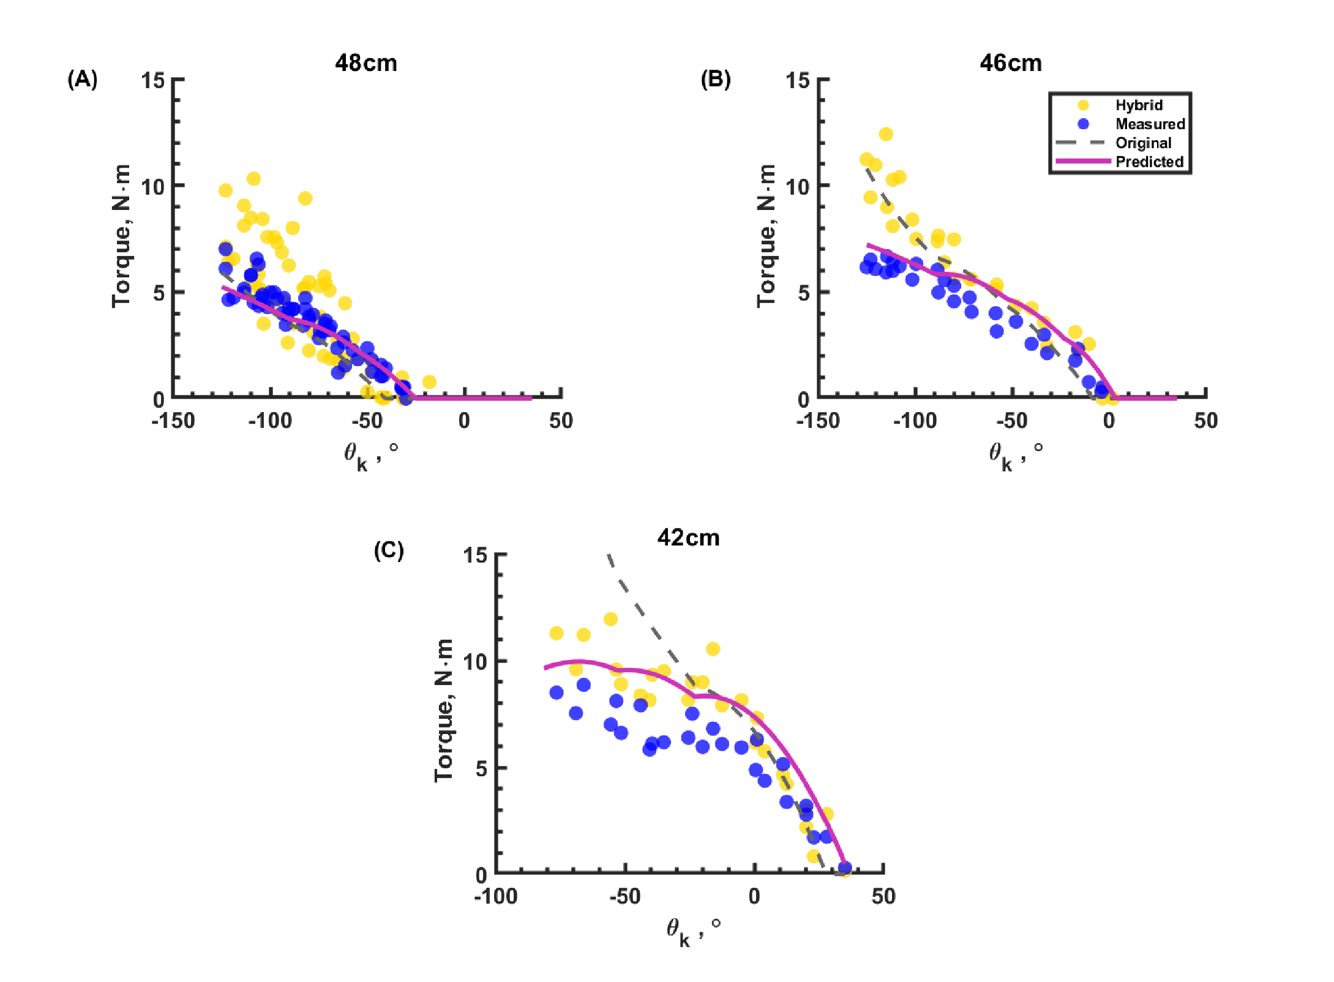
CH. 4 · PINNED EXTENSOR
The extensor wraps the joint - and χ₃ recovers the length it loses there
χ₀ = −6.38 mm
extensor length offset: OPPOSITE sign to the flexor's +3.94 mm
χ₃ = 0.158
fractional wrap loss acting on arc length × ζ²
0.49–1.53 N·m
corrected RMSE, improved in every used test (6/6)
2.50 → 1.00 / 2.55 → 1.10 N·m
training / validation triple means; FVU < 1 on all but the 43.2 cm tendon test
Ch. 4, Table ExtPinGof + follow-up identification (adopted χ values); wrap loss: Eq. Δl = χ₃ R |Δθ| ζ²
21
Notes:
The 45.7 cm test trained the extensor fit (RMSE 2.178 to 0.490 N-m); the validation trio is 40.0, 40.0-tendon, and 46.5 cm (triple mean 2.55 to 1.10 N-m). The stiffness pair is locked to the flexor-identified values and never searched. Initial single-bracket extensor values were chi0 = -10.9 mm, chi3 = 0.123 (Table OptCoeff). Q: why does chi0 flip sign? A: wrapping consumes usable length, so the extensor behaves as if longer; its zero point shifts opposite to the flexor's.

Slide 22
CH. 4 · VALUES OF RECORD
One stiffness pair of record spans the flexor and extensor configurations
Term
Value
Source
Row
READ THIS TABLE LIKE THIS
The pinned-flexor data admit a family of stiffness pairs of comparable fit quality.
The adopted pair was chosen by a requirement external to the fit: both redesign configurations must clear the required 5% torque-overshoot target.
The extensor never searches stiffness; it inherits it.
Flexor χ₀
+3.94 mm
App. C
77
Flexor χ₁
3.998×10⁴ N/m
App. C
77
Flexor χ₂
1.473×10⁴ N/m
App. C
77
Extensor χ₀
−6.38 mm
App. C
32
Extensor χ₁ (locked)
3.998×10⁴ N/m
App. C
77
Extensor χ₂ (locked)
1.473×10⁴ N/m
App. C
77
χ₃ (extensor)
0.158
App. C
32
Appendix C, Table app_xi_values; flexor front row 77 of 212, extensor front row 32 (pair locked to row 77)
22
Notes:
Mats of record: minimizeFlxPin10_results.mat row 77, and minimizeExt10mmX3_results.mat row 32 (pair locked to row 77). Initial single-bracket values (Table OptCoeff): flexor 11.9 mm / 1.02e5 / 1.06e4 N/m; extensor -10.9 mm / 0.123. Q: how sensitive is the redesign to the pair choice? A: the adoption screen chose the pair meeting both targets simultaneously: +5.00% flexor and +5.043% extensor at adoption, refined to +5.01% and +5.02% (Appendix C).

Slide 23

CH. 4 · BIOMIMETIC KNEE
The biomimetic knee meets or exceeds human flexor torque over most of the range of motion
SHORTFALL
60–100°
(±20%: 78–103°)
⌀20 mm, l₀ = 42.0 cm
RMSE 1.80 · FVU 0.05
max resid 3.57 N·m
⌀10 mm panel:
RMSE 0.30 · FVU 0.01
At 620 kPa the BPA exceeded the test femur's ultimate strength; remaining points taken at 560/421/325/281 kPa.
blue = measured · magenta = corrected prediction · dashed orange = BPA characterization alone · black dotted = human maximum-isometric torque
Ch. 4, Fig. FlxGrp + Table TorqueFit; human curve: Gait2392 maximum-isometric torque (Delp 2007; Seth 2018)
23
Notes:
Pinned-flexor chi values transferred unchanged. Panel A: ⌀10 mm, l0 = 41.5 cm, 21 mm tendon, 604 kPa, RMSE 0.3007, FVU 0.0102, max 0.4647. Panel B: ⌀20 mm, l0 = 42.0 cm, 15 mm tendon, 620 kPa, RMSE 1.8024, FVU 0.0499, max 3.5678. Note: the chapter text gives 42.0 cm for the ⌀20 test while its summary table row lists 41.5 cm; the slide follows the text. Q: is the 60-100 deg shortfall fixable? A: yes by route redesign: the two-BPA flexor route exceeds the human envelope at every angle (next slides).

Slide 24

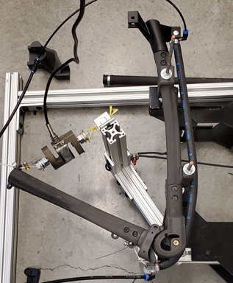
CH. 4 · BIOMIMETIC KNEE
Biomimetic extensor: corrections cut the error, but prediction still sits above measurement
the route passes between the femoral condyles near the ICR: an approximation with inherent error
CLAIM CONTROL
Improvement is unambiguous; the corrected prediction still sits above the measured torque, so level validation is not claimed.
⌀10 mm extensor on the four-bar knee, l₀ = 51.8 cm
0.89
RMSE (N·m) with pinned-extensor χ (figure)
1.17
RMSE (N·m) at values of record (rigid: 3.03)
0.67
FVU at values of record (rigid: 4.49)
Ch. 4, Fig. Ext10mm_52cm + Table TorqueFit; adopted values: Appendix C, adopted correction-term values
24
Notes:
Measured torque is significantly smaller than both the original and the hybrid predictions; the corrected prediction more closely matches but remains higher than measurement, so level validation is not claimed. With the pinned-extensor chi values (the figure): RMSE 0.8920, FVU 0.3396, max 1.4188. At the values of record: max residual 2.21 N-m against a rigid baseline of 5.59. Q: why does extensor validation lag the flexor? A: the route wraps the joint through sequential contacts and passes between the femoral condyles near the ICR; the path model itself is the approximation.

Slide 25
CH. 4 · ROUTE REDESIGN
The χ values of record drive a redesign ladder: direct routes, a cam, then pulleys
1 · DIRECT ROUTES
two ⌀20 mm BPAs each
flexor +5.01% @ −107°
extensor +5.02% @ −220.2°
superseded by cam
2 · CAM EXTENSOR
design of record
+30.83% vs required envelope
+39.77% vs plain human
269–507 kPa to meet it
3 · MONO-PULLEY
knee flexor · 1:1 tackle
peak 81.23 → 85.74 N·m
+4.51 N·m (+5.6%)
no mechanical advantage
4 · BI-PULLEY SCREEN
five anatomical sites
all five rejected
clearances 4.26–19.14 mm
vs 25 mm required
targets: vastus medialis (extensor) · biceps femoris short head (flexor) · required envelope = human curve + 5%
Ch. 4, follow-up identification and route redesign + redesigned-route results; solver: surrogateopt → patternsearch
25
Notes:
Direct flexor: predicted knee-axis torque -81.23 to -3.86 N-m vs human-scaled requirement -23.16 to -2.46 N-m (peak 23.16), exceeded at every angle; margin fraction 0.0501 vs required 0.05. Direct extensor: 35.45-109.4 N-m vs 20.25-50.32 N-m, zero shortfall points. Solver budgets: surrogateopt 3,000 evals (direct extensor), 1,000 (flexor), 1,000 + 1,500 refinement (cam), then patternsearch 15,000. Q: why is the flexor margin also about 5%? A: the adoption rule for the stiffness pair required both configurations to clear the +5% envelope, and the flexor model still assumes both actuators share one attachment route; making the mirrored pair explicit is the next refinement. Moved off-slide: shared plan - two ⌀20 mm BPAs per route, a 620 kPa pressure ceiling, and maximum usable contraction 0.255; the direct routes were later superseded by the cam extensor (step 2 of the ladder); flexor route −81.23 to −3.86 N·m vs human-scaled −23.16 to −2.46 N·m, direct extensor 35.45–109.4 vs 20.25–50.32 N·m, envelope exceeded at every angle.

Slide 26
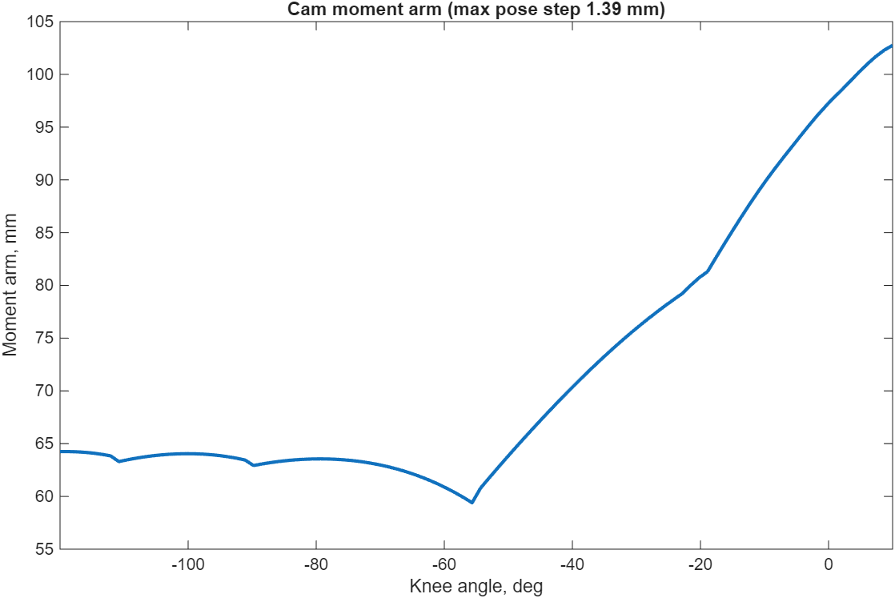
CH. 4 · ROUTE REDESIGN
The cam extensor is the design of record: +30.83% margin with hardware-safe geometry
+30.83%
margin vs required envelope (human + 5%)
+39.77%
margin vs plain human target
269–507 kPa
pressure to meet envelope (VTUG floor 150 kPa)
96.9 mm
tibial-wrap bend radius
43.1 mm
condyle clearance at 10° extension
72.4 mm
mean moment arm (span 59.4–102.8 mm)
extensor cam, design of record: moment arm vs knee angle
HARDWARE BEGUN · rebuilt ⌀20 mm extensor route
first isometric points: 1.163 / 7.849 / 23.437 N·m at 10° / 11° / 10°, hung loads 3.7 / 25.2 / 76 N at 388.5 / 388 / 592 kPa; full sweep pending
Ch. 4, redesigned-route results (cam paragraph); figure: Mesh_Optimization\Results\Vas_Pam_20mm_cam_winner_4.png (print-QC pass)
26
Notes:
The final geometry folds the optimizer winner together with a verified adjustment of the distal route point and tendon length; the winner alone carried +31.30% and +42.34% at the same checks. Envelope pressures sit comfortably above the 150 kPa regulated floor of the VTUG valve manifold that supplies the hardware. Hardware: the first and third points sit at essentially the same knee angle and span a twentyfold range of held torque; the full sweep and the flexor measurements are pending. Q: is the cam margin sensitive to the adopted chi pair? A: margins are evaluated under the values of record, whose adoption rule already required both routes to clear +5%.

Slide 27
CH. 4 · ROUTE REDESIGN
Pulleys buy reach at the knee, and screen the anatomy: geometry binds, not torque
MONO-PULLEY · KNEE FLEXOR
BI-PULLEY SCREEN · FIVE OPENSIM MUSCLE SITES
81.23 → 85.74 N·m
peak knee-axis flexion torque
Muscle site
Objective
Outcome
soleus
0.997
nonpositive margin
tibialis anterior
0.929
nonpositive margin
+4.51 N·m (+5.6%)
from the redirect alone
rectus femoris
3.42
worst constraint 0.242
medial gastrocnemius
101*
sentinel · exit flag −2
biceps femoris sh. head
101*
sentinel · exit flag −2
≤ 0.803 N·m
off-axis · under 1% of peak
* infeasibility sentinel objective
4.26–19.14 mm vs 25 mm
minimum route-to-route clearance · all five sites rejected
×3.51 / ×3.70
human flexor scale 23.16 N·m · direct / pulley
optimizer-stage results · not yet in the OpenSim or MuJoCo model trees
Ch. 4, mono- and bi-pulley tendon routing + Table bipulley_batch
27
Notes:
Pulley run: collision-feasible, zero bound violations, pattern-search exit flag 1; objective values are not commensurable across families (0.08465 pulley vs 74.47 direct). Insertion-side measure of the pulley peak: 85.56 N-m. Bi-pulley: the medial-gastrocnemius run records no finite clearance (worst constraint 10, exit flag -2); rectus femoris worst constraint 0.2423. These are optimizer-stage results, not yet propagated into the OpenSim or MuJoCo model trees. Q: why 25 mm clearance? A: two 10 mm actuator radii plus a 5 mm bundle margin. Q: does the bi-pulley failure kill the concept? A: no; it redirects design toward clearance-relaxed attachment sites. Moved off-slide: the mono-pulley is a single tackle-line part at 1:1 gain; peak predicted flexion torque at the knee axis 81.23 → 85.74 N·m; the +4.51 N·m (+5.6%) gain comes from the redirect alone, with no mechanical advantage; off-axis torque ≤ 0.803 N·m is under 1% of peak; the human flexor scale of 23.16 N·m is exceeded ×3.51 (direct) / ×3.70 (pulley); minimum route-to-route clearances 4.26–19.14 mm vs the 25 mm requirement of two ⌀10 mm actuator radii plus a 5 mm bundle margin - geometry binds, not torque.

Slide 28
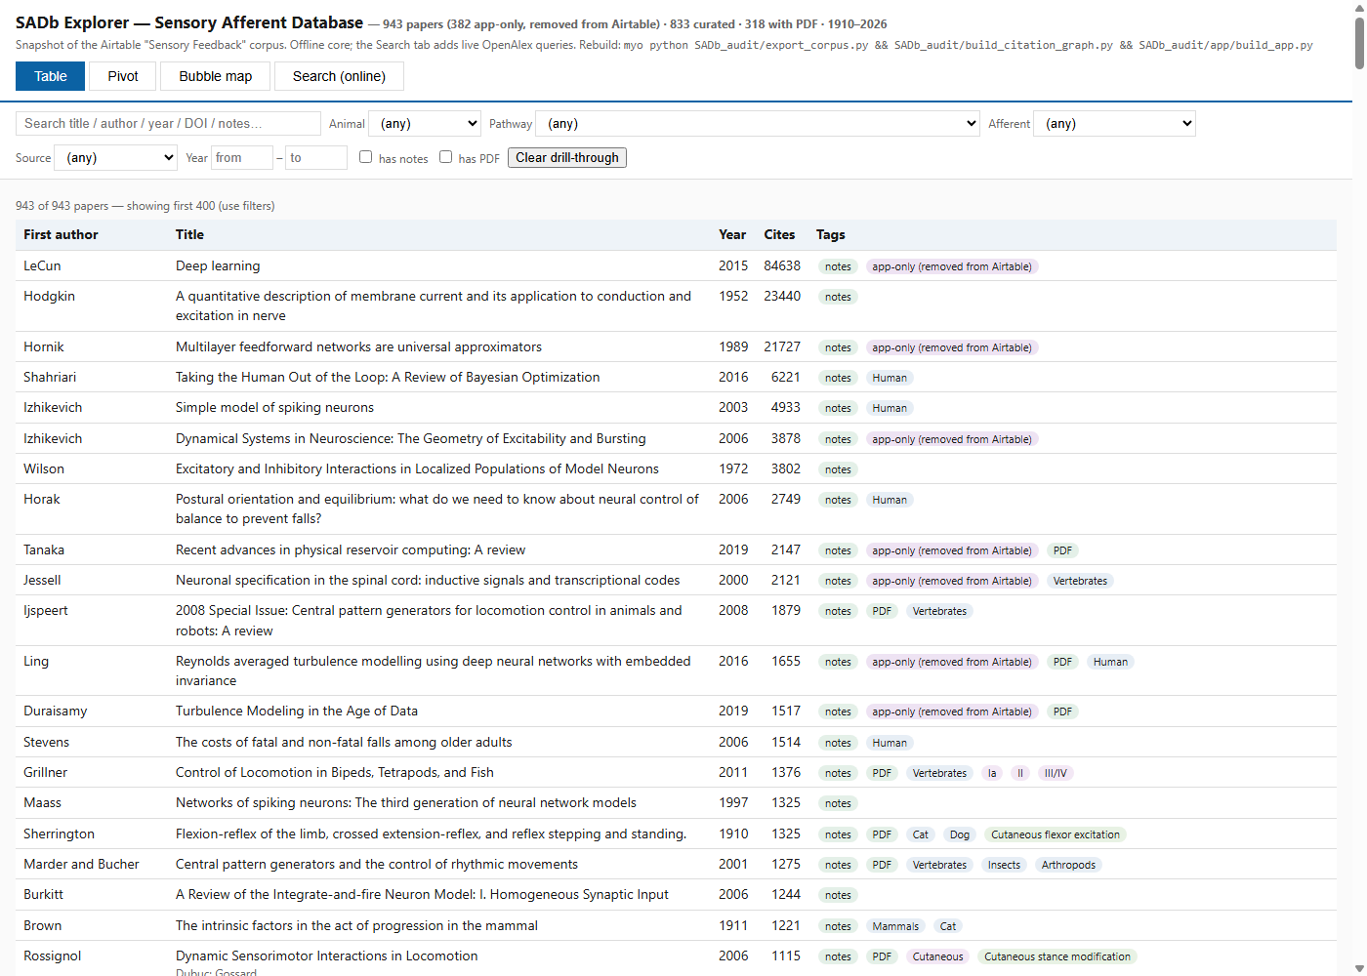
CH. 5 · SENSORY AFFERENT DATABASE
A century of scattered afferent physiology, consolidated into one audited, offline-searchable resource
943
papers in the audited corpus
561
retained papers (382 archived, none destroyed)
CITATION GRAPH
730 papers · 11,130 directed pairs · 18 Louvain topic clusters
THREE HOMES RECONCILED
Zotero 538 · group library 911 (27 collections) · Airtable 99 → one audited corpus
the packaged SADb Explorer: single file, runs offline in a browser · table view with curation-state tags
WORKING BASE
957 records: 561 papers · 39 pathway · 244 model · 109 review · 4 recorder — 43 under the 1,000-record cap
Dissertation Ch. 5 (§A Structured Afferent Resource, §Audited Corpus and Curation Coverage); Bolen et al., SfN 2023
28
Notes:
Provenance: the database's three homes did not agree, so the 2026 campaign opened with a record-by-record reconciliation on DOI and normalized title (Ch. 5, line 14). No record was destroyed in the prune: every deletion was snapshotted, and the packaged explorer carries the 382 cut papers under an archived flag (line 20). Anticipated question: why build your own explorer app? Answer: an off-the-shelf bibliometric viewer was tried and retired within weeks - one crowded picture, no drill-through from cluster to papers, mega-cited classics dominating every view; this corpus needs filter-by-afferent-class, pathway-to-papers walks, and two-dimensional pivots (line 22).

Slide 29
CH. 5 · SENSORY AFFERENT DATABASE
The machine drafts at scale; the vocabulary, every judgment call, and every deletion stay human
RECONCILE
Zotero 538 + group 911 + Airtable 99, matched record by record on DOI and title
IMPORT
gap imported in verified batches · 372 auto-classified · Papers table 532 → corpus 943
CURATE
374 papers drafted in 15 gated batches · 164 flagged judgment calls surfaced for ruling
PRUNE
3 approved stages removed 436 records (382 papers + 54 orphans) · 351 protected · nothing destroyed
GROUNDING IS THE BINDING CONSTRAINT
PDF-first recovery: 47 of 55 flagged papers · authenticated browser: abstracts for 24 of 70 · the rest stay bare by rule, never guessed
Dissertation Ch. 5 (§A Structured Afferent Resource, §AI-Assisted Literature Triage); Bolen et al., SfN 2024
29
Notes:
Evidence detail: 374 papers machine-drafted in fifteen batches, each batch passing automated vocabulary, abstract-paste, and duplicate gates before anything was written, and every record verified against its grounding text after the write (Ch. 5, line 18). Grounding stayed the binding constraint: a PDF-first rule recovered 47 of 55 flagged papers, an authenticated browser session recovered abstracts for 24 of 70, and the rest stayed bare by rule (line 18). The 2024 comparative study found AI tools accelerate triage but still require substantial human oversight; the 2026 campaign is that finding made operational (lines 39-41). Anticipated question: what did the AI actually do? Answer: batch drafting from grounded text plus the gates; the human held the vocabulary, the 164 flagged judgment calls, and every single deletion, each prune stage waiting for explicit approval (lines 20, 41).

Slide 30
CH. 5 · SENSORY AFFERENT DATABASE
A pathway record maps to a circuit edge: class fixes the signal, phase fixes the gating, action fixes the sign
THE CONTROLLER'S SENSORY CHANNELS
PRINCIPAL PATHWAY RECORDS · LINKED CORPUS PAPERS
Ia
muscle length and velocity
stretch reflex; phase-dependent modulation
Ib stance to swing (the load gate)
17
Cutaneous flexor excitation
16
II
static muscle length
position sense; interjoint coordination
Ia or II stance to swing
10
Ia monosynaptic excitation
7
Ib
whole-muscle force
load-dependent stance regulation
Ia reciprocal inhibition
6
Ib disynaptic excitation (reversal)
6
heel / toe
contact events
discrete stance-swing boundaries
Ib disynaptic inhibition
5
Type II excitatory
5
Rybak 2006
two-level CPG
Geyer 2010
muscle-reflex walking
Deng 2019
two-layer walker
the Models-table lineage the controller instantiates · 39 pathway records · 258 robot-and-simulation translation notes
Dissertation Ch. 5, Tables 5.1-5.2 (§Toward Robot and Simulation Use); Ch. 6 implements the mammalian subset
30
Notes:
Evidence detail: the Feedback table's naming grammar (afferent, action, side, joint, phase) is the same grammar a circuit edge needs, so translating a record into a controller connection is a lookup rather than a literature search (Ch. 5, line 45). Linked-paper counts are unchanged between the full audited corpus of 943 and the retained 561 (Table 5.2 caption, line 64). The 39 records reach beyond the mammalian core - chordotonal organs, trochanteral hair plates, campaniform sensilla, group III/IV fatigue, and one paper each for somatosensory, vestibular, and visual postural contributions (line 83). Anticipated question: did the database actually wire the Ch. 6 controller? Answer: the afferent classes monitored, the signal each channel carries, and the connection rules all trace to records held here; the controller implements the mammalian subset (lines 12, 45, 83).

Slide 31
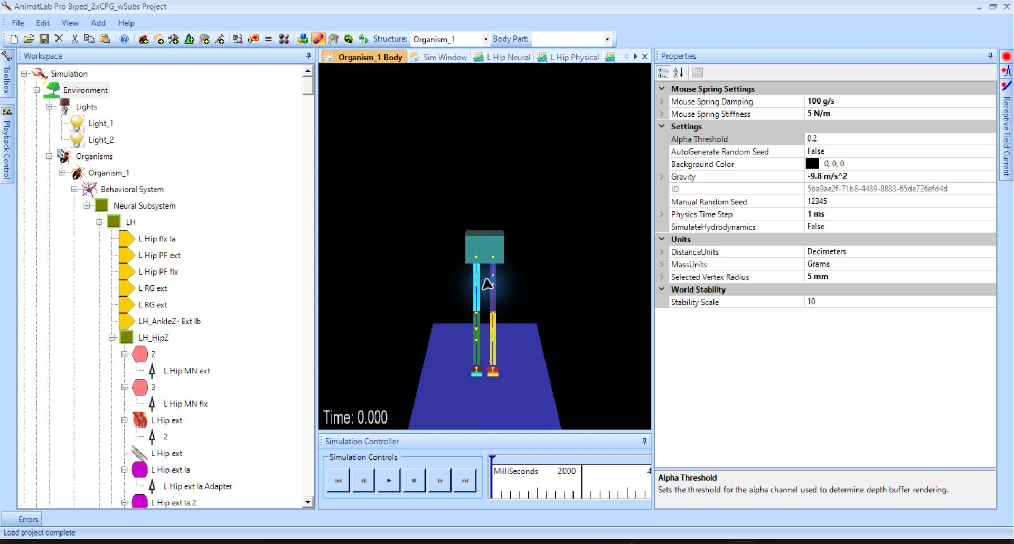
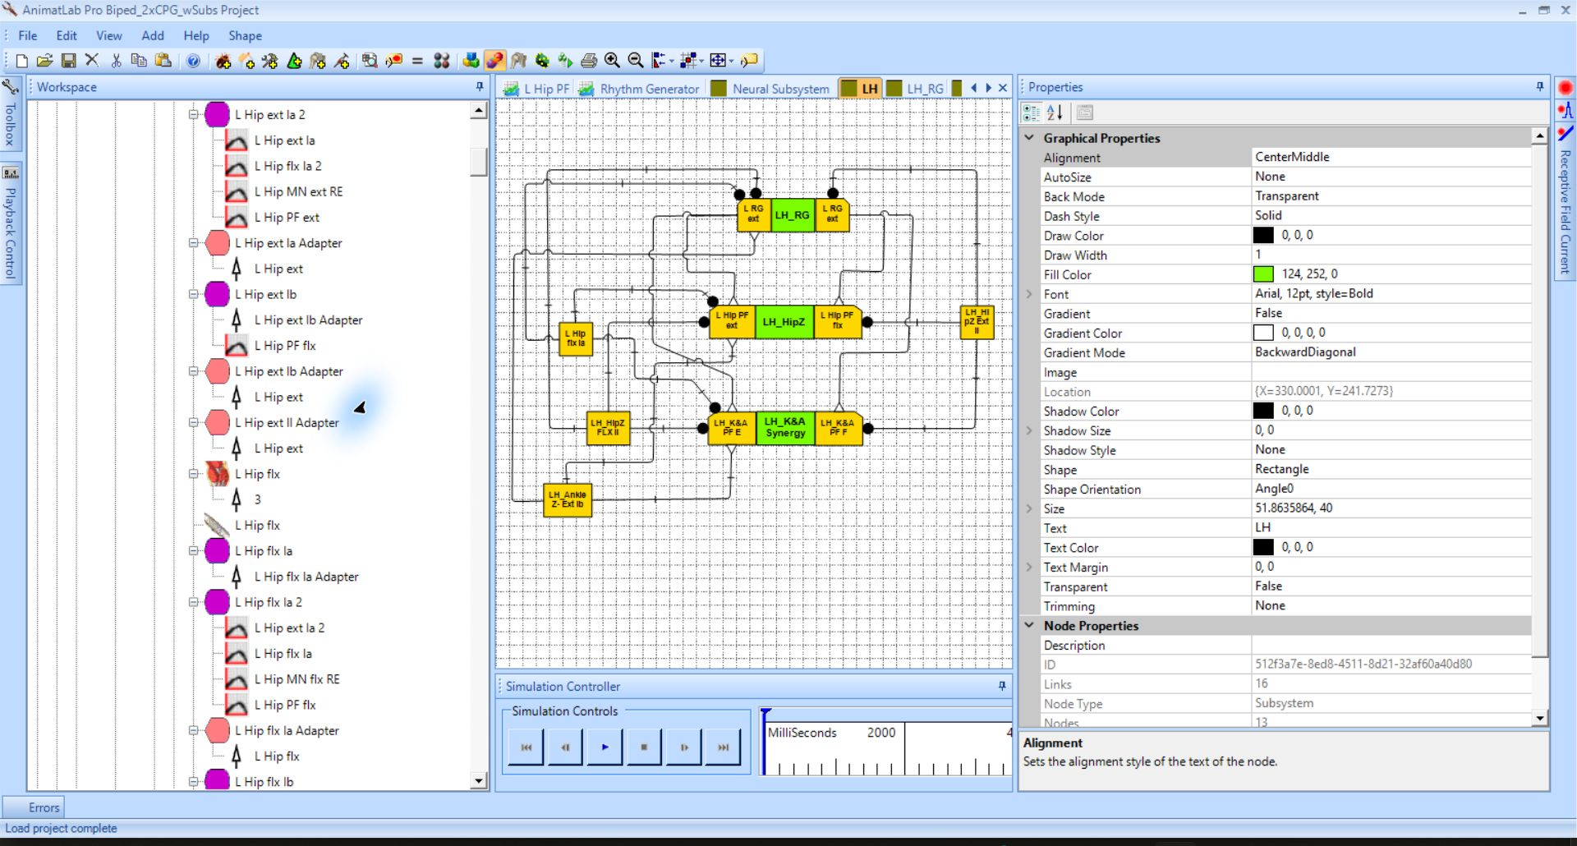
CH. 6 · SYNTHETIC NERVOUS SYSTEM · PRIOR WORK
The direct ancestor: a hand-tuned AnimatLab bipedal walker whose limits set the verification-first agenda
THE MODEL
9 rigid bodies · sagittal hinges · antagonistic Hill-type pairs at hip, knee, ankle · passive-spring toe
THE CONTROLLER
two-layer CPG (RG / PF) + sensorimotor layer with Renshaw-like recurrent inhibition · Ia and Ib wired
the working project: biomechanical body at initialization
THE LIMIT
gains never systematically tuned · no ground-contact signals · every current and weight set by hand
suspended stepping ≈ 4 Hz (human gait ≈ 1 Hz) — on the ground it could not support the body
hand-tuning consumed the bulk of the effort and did not generalize — hence verification first
the expanded left-side controller subsystem
Dissertation Ch. 6 §Prior Work (with C. Morrow); Li et al. 2017; Deng et al. 2019; 2021 NIH BRAIN Initiative Meeting
31
Notes:
Evidence detail: nine rigid bodies, sagittal-plane hinges, antagonistic Hill-type pairs at the hip, knee, and ankle, and the author's passive-spring toe; the two-layer CPG plus a sensorimotor layer with Renshaw-like recurrent inhibition received Ia and Ib feedback, but the gains were never systematically tuned, no ground-contact signals were modeled, and every current, weight, and tension parameter was set by hand, one at a time (Ch. 6, lines 18-20). Suspended alternating stepping ran at approximately 4 Hz against roughly 1 Hz for human gait, and was presented at the 2021 NIH BRAIN Initiative Investigators Meeting (Ch. 7, line 26). Lowered onto a ground plane, the same patterns could not support the body or generate forward motion (Ch. 7, line 28). The current instrumented model records a 10 s phase-1 run - 50,001 samples at a uniform 0.2 ms interval - demonstrating acquisition, not validated walking (Ch. 6, line 135). Anticipated question: why keep AnimatLab around? Answer: the lineage's reference models are archived there and re-run headless by the verification harness, and new circuit organizations are prototyped in the same format (Ch. 6, line 28).

Slide 32
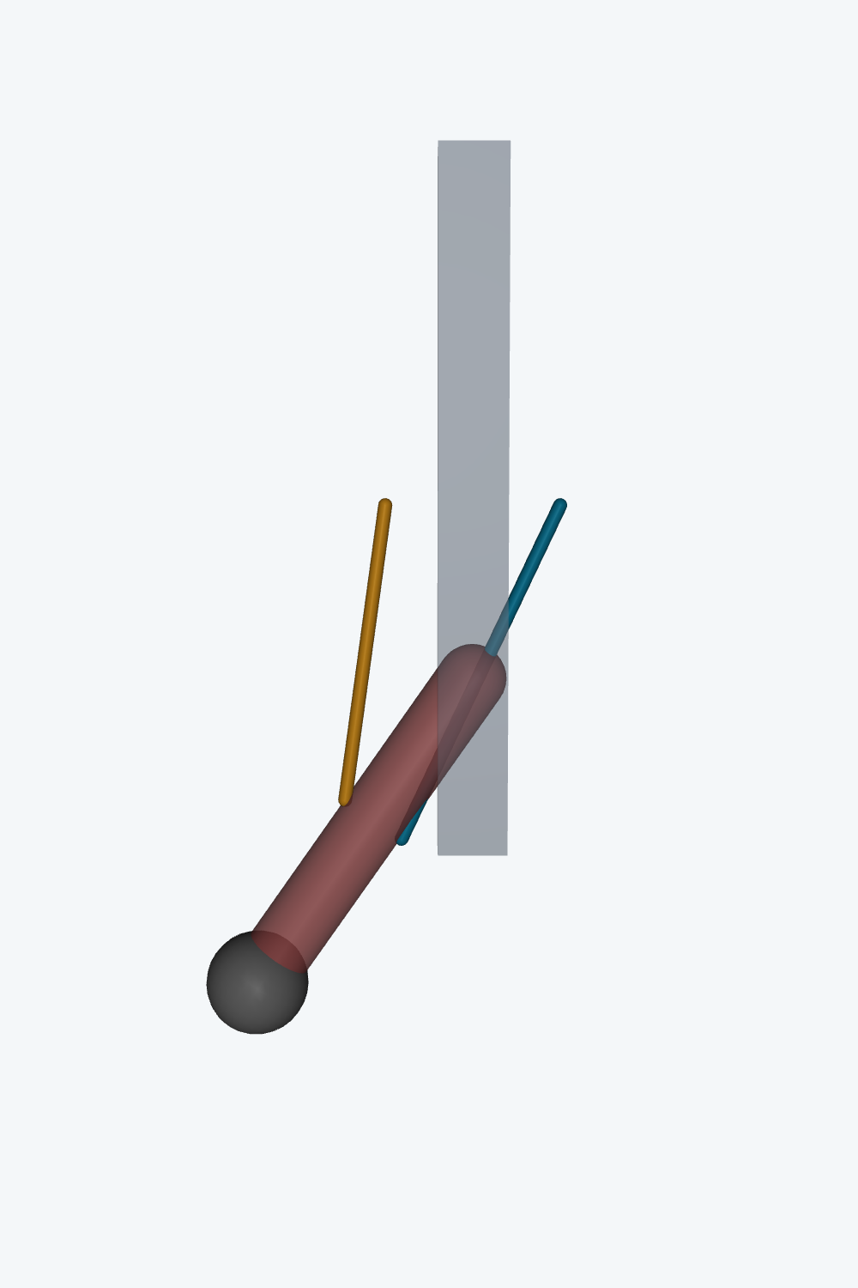

CH. 6 · SYNTHETIC NERVOUS SYSTEM · TOOLCHAIN
A toolchain that did not exist: audited model conversion, BPA force inside the loop, and SNS blocks in Simulink
converted robot, reference pose
synthetic antagonist-BPA knee, −35°
the library's seven core masked blocks
OpenSim → MuJoCo
92 muscle-tendon actuators · attachment geometry audited · joint signs verified dynamically
BPA force in the loop
Ch. 3 force surface + Ch. 4 χ force balance computed in Python at every step
Simulink SNS library
7 core blocks, 12 before the spiking additions · knee-reflex demo: sag 2.00° with the reflex vs 7.85° without
on this coupling: a 410-neuron two-level spinal network · 2 ms neural step matched to the physics engine · isolated rhythm generator oscillates at ≈0.9 s, legs in antiphase
Dissertation Ch. 6 §A Neuromechanical Simulation Toolchain; MyoConverter (Caggiano 2022); SNS-Toolbox (Nourse 2023)
32
Notes:
Evidence detail: no physics engine carried the robot's custom muscle routing together with the BPA force model and an SNS, so the pipeline is itself a series of tools (Ch. 6, line 12). MyoConverter performs the base conversion; repair scripts correct mirroring and sign defects and re-audit against the OpenSim source, in a recorded, re-runnable environment (line 71). All 92 muscle-tendon actuators carried, attachment geometry audited, joint signs verified dynamically - each actuator activated alone, the sign of its torque identifying its action (line 73). The Simulink library runs in base Simulink without toolboxes (line 91). Anticipated question: why two engines? Answer: MuJoCo is the physical engine with the custom routing; Simulink assembles the same component models in a standard controls-engineering environment - and the rhythm core had to reproduce itself across both before any result was trusted (lines 91, 113).

Slide 33

CH. 6 · SYNTHETIC NERVOUS SYSTEM · VERIFICATION
The contact-driven rhythm core, rebuilt in two engines: exact period agreement, trace r ≥ 0.99996
PERIOD
1.000 s vs 1.000 s — 0.0% error · antiphase exact · 10 of 10 bursts
TRACES
r = 0.99996–0.99998 at a −2 ms lag · RMSE 0.099–0.111 mV
ARCHIVED MODELS, HEADLESS
11 / 11 targetable metrics pass on re-run
left / right RG extensor voltages: NumPy reference vs Simulink
heel trains removed → static latch in every implementation: contact feedback is drive architecture, not perturbation
Dissertation Ch. 6 §Cross-Platform Verification (NumPy reference vs native Simulink; 12 s runs at a 2 ms step, 1 Hz heel trains)
33
Notes:
Evidence detail: the harness is defined around the W2L contact-driven core - four rhythm-generator half-centers built from spiking neurons whose persistent sodium current terminates each burst, plus graded pattern-formation and sensory cells - implemented twice from one connectivity specification and driven with an identical protocol (Ch. 6, line 113). The residual minus 2 ms lag is consistent with the one-step delay of the discrete Simulink solver (line 146). The headless reruns extract eleven targetable metrics automatically; all eleven pass (line 159); in the modern W2L model the flexor half-centers peak at minus 56.4 mV and never cross the minus 55 mV threshold, so the rhythm rides graded extensor-flexor antiphase rather than flexor spiking. Anticipated question: why does cross-engine agreement matter? Answer: an SNS is a mathematical object that must survive translation between the tools it is built, verified, and deployed in - the formalism carries the dynamics, not any particular simulator (Ch. 7, line 14). Removed from slide, kept here: archived bilateral contact-driven model 0.450 s / 0.467 s at 0.529 cycle lag (r = 0.976); modern W2L 2.25 Hz, flexor peaks -56.4 mV never crossing the -55 mV threshold, graded antiphase r = -0.996; Li walker 0.637 m/s, steps 1.299+-0.024 / 1.333+-0.080 s, duty 0.443 / 0.555.

Slide 34
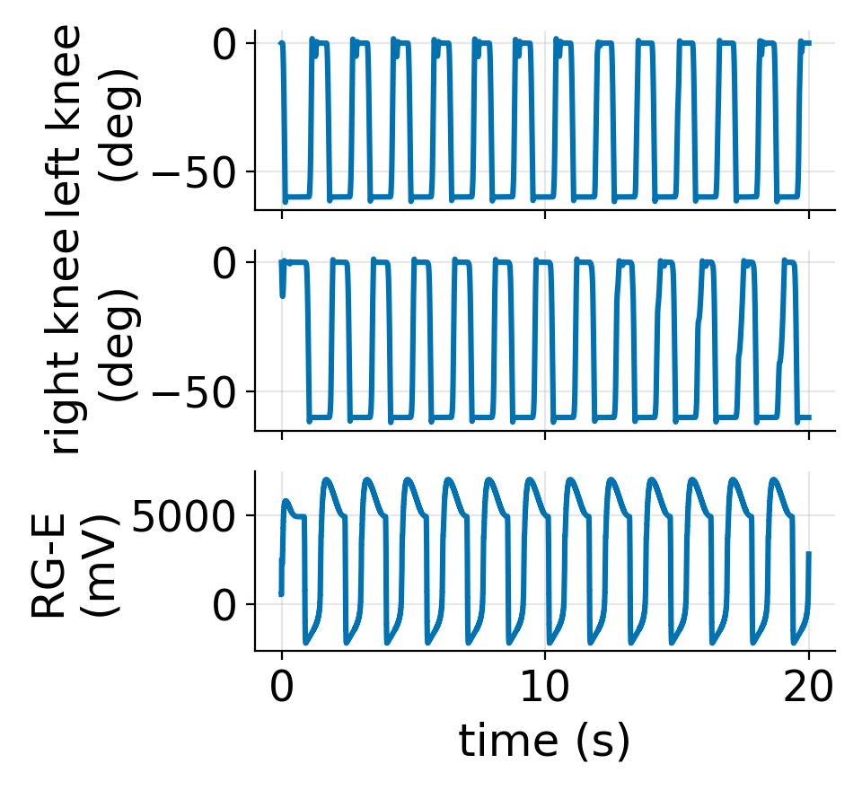
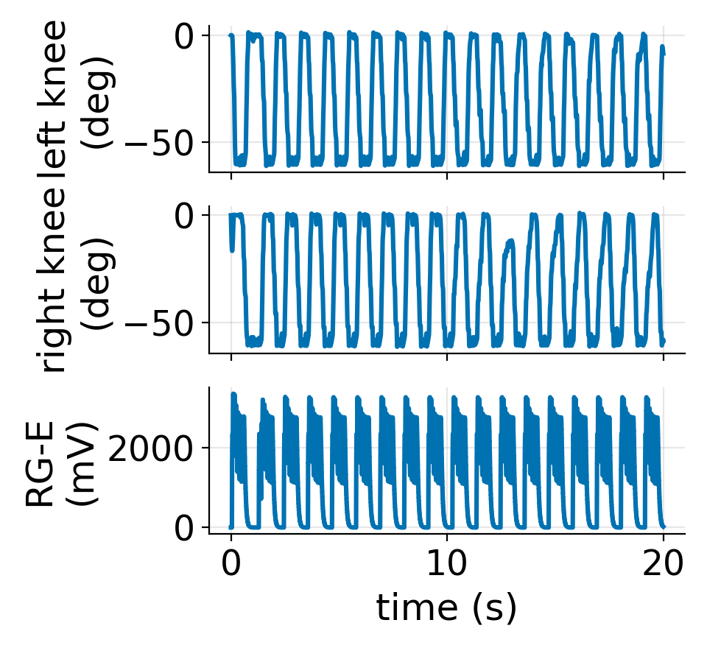
CH. 6 · SYNTHETIC NERVOUS SYSTEM · END-TO-END CHAIN
The characterized BPA model drives a stepping, multi-joint walker in MuJoCo
ON THE GROUND, SAME WEIGHT
W2L stands but does not walk: heel duty zero, +0.001 m · Li: no stance in 7 drop variants
the missing piece is balance and weight-bearing — not rhythm, actuators, or engines
SINCE SUBMISSION
the spiking twin matches the air gate (knee 62.7° / 61.9°, 9 / 9 contacts) and outscores non-spiking in tuning: 266.9 vs 185.9
artifacts: bpa_spk_best_20261003.npz · CURRICULUM_RUN_20261003.log
non-spiking — the chapter's air gate
(bpa_ns_best_20261003.npz)
spiking twin — since submission
(bpa_spk_best_20261003.npz)
1.542 s
knee-flexion period
63.5°
knee-flexion range
880 / 1372 N
peak BPA force, L / R
372 kPa
peak pressure — 60% of ceiling
70%
body weight on the harness
7 / 5
heel-contact episodes, L / R
Dissertation Ch. 6 §BPA-Actuated Walker in MuJoCo — air-stepping gate; ground failures reported with equal weight
34
Notes:
Evidence detail: the walker geometry of the prior AnimatLab model exported to MuJoCo and driven by antagonistic BPA pairs under the split contact-driven network, with actuator forces computed by the Chapter 3 force model (Ch. 6, line 163). The harness carries 70% of the 411 N body weight; peak BPA forces of 880 N and 1372 N arrive at 372 kPa, 60% of the 620 kPa ceiling, so actuator sizing operates inside the characterized pressure range. Ground negatives: the W2L gate model stands in full support but does not walk - heel duty zero, forward displacement plus 0.001 m - and the MuJoCo Li re-implementation produced no stance episodes in any of seven drop-protocol variants (line 165). Together with the latch result these localize the open problem in the balance and weight-bearing layers, not the rhythm, the actuators, or the engines (lines 148, 165). Anticipated question: is this walking? Answer: no - it is marching in a harness that unloads 70% of the body; the chapter reports the ground failures with the same weight as the air gate. Figure provenance: both knee panels are regenerated from the run artifacts with the column order fixed by the campaign code (w2l_mujoco/_curriculum_bpa.py JNTS = hip_L, knee_L, ankle_L, hip_R, knee_R, ankle_R), with knee ranges asserted against each run's own metrics.

Slide 35
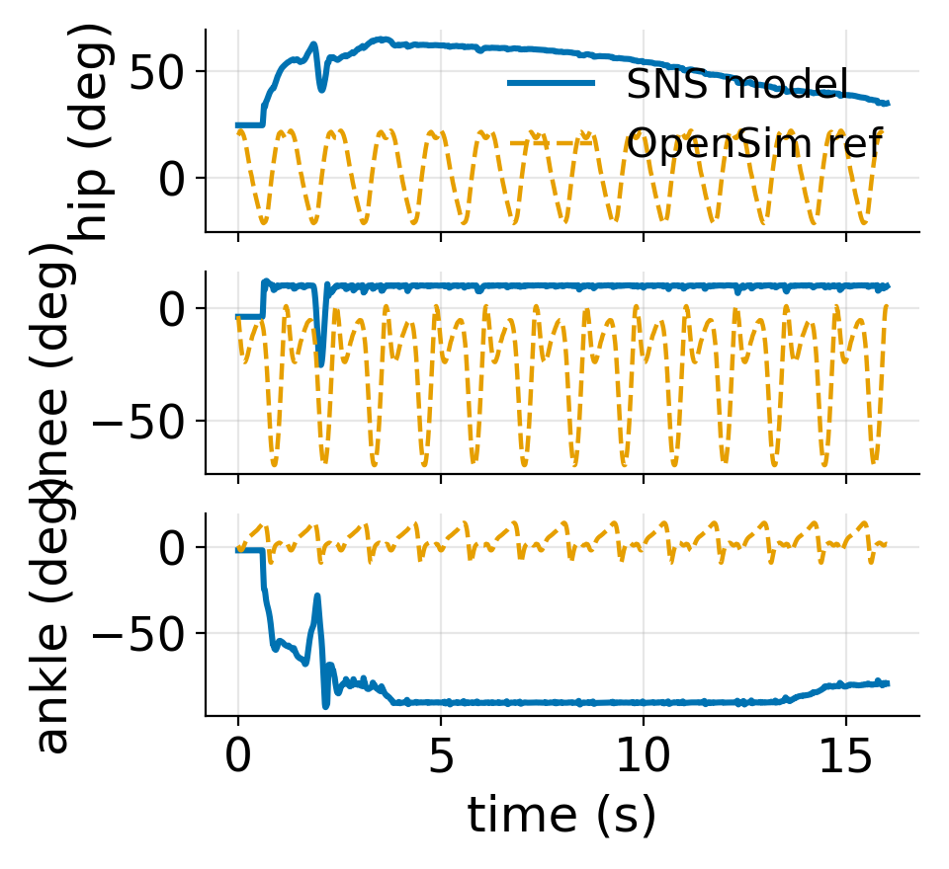
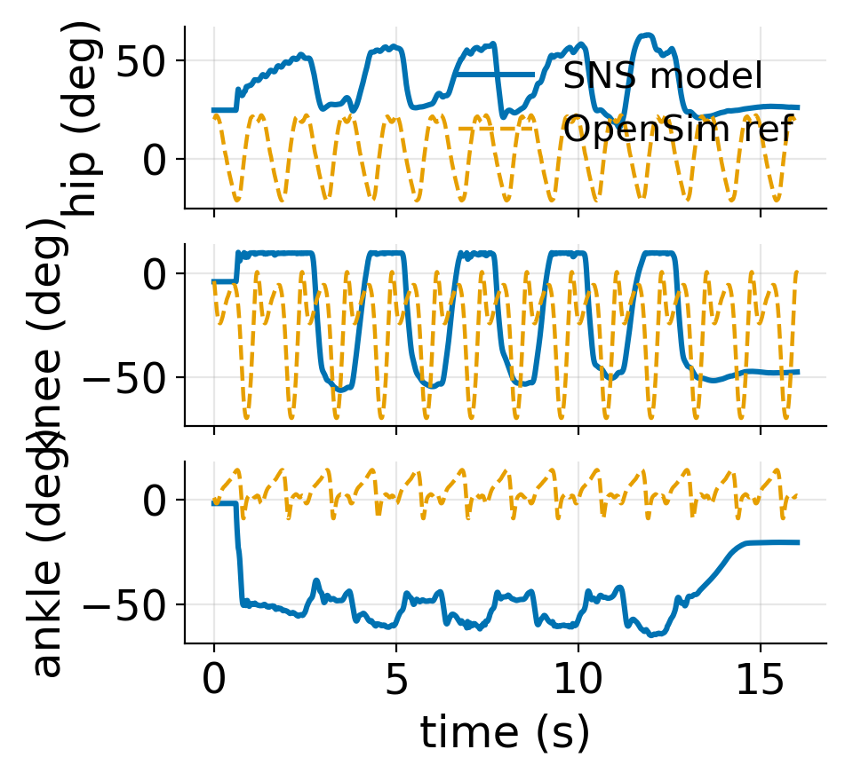
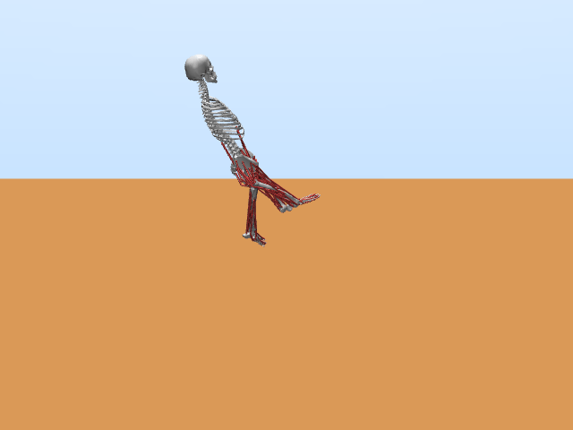
CH. 6 · SYNTHETIC NERVOUS SYSTEM · HONEST SCOPE CHECK
Tuning to one reference transfers poorly: 43 diverse human reference cycles score one to two orders worse
CYCLE-SHAPE KINEMATIC SCORE (0 = PERFECT)
w2lvar
tuning-ref −144.5
library mean −5808
closest
s3kpruned
tuning-ref −176.1
library mean −6924
s3k
tuning-ref −186.4
library mean −8776
W2L-layout variant — closest to the library
six-synergy variant — farthest
syn6
tuning-ref −200.4
library mean −9961
NOT A RUNNING ARTIFACT
s3k on the ten walking refs alone: −8816 vs −8761 running-only — all four walk right-leg-only or asymmetric
farthest
43 references: 32 running · 10 walking · 1 predicted
the robot-lineage configuration agrees most closely
production s3k, ground evaluation (animated in the talk)
Dissertation Ch. 6 §Gait-Validation Sweep, Table 6.1 — library: 32 running + 10 walking + 1 predicted cycle
35
Notes:
Evidence detail: the library holds 32 running trials from eight subjects at four speeds, ten walking references (seven prescribed, 0.5-2.0 m/s, plus three self-selected), and Case_40_motion, the Falisse predicted-walking cycle (period 1.11 s, duty 0.57). The score is the production pipeline's cycle-shape kinematic score: 0 is perfect agreement and minus 25 is the fixed no-cycle fallback (Ch. 6, line 169). The gap is not an artifact of the running trials - the production configuration's walking-only mean of minus 8816 is slightly more negative than its running-only mean of minus 8761 - and all four configurations produce right-leg-only or asymmetric gait (line 187). For three of four configurations the most negative single reference is Case_40_motion; the W2L-layout variant's is subject08_Run_20002 (Table 6.1). Anticipated question: why present a mostly negative result? Answer: it quantifies, honestly, how far single-reference tuning transfers; the family-level signal - the robot-lineage configuration closest, the most human-derived farthest - is consistent across both evaluations, and closing that gap is a tuning question, not a tool question (line 187).

Slide 36
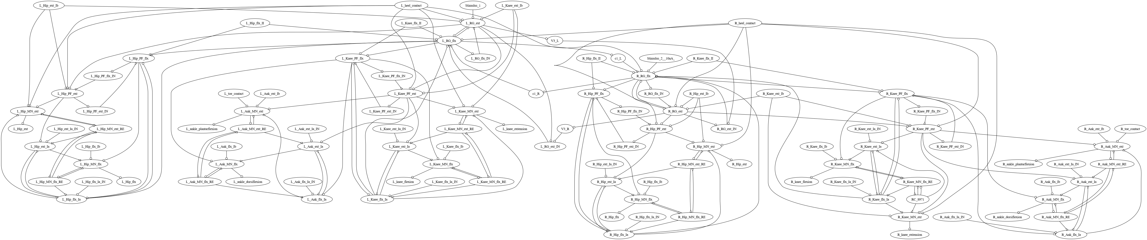
CH. 6 · SYNTHETIC NERVOUS SYSTEM · STIMULUS AND DELETION
The laboratory's first lesion and stimulus experiments read like the physiology they imitate
PATHWAY REMOVAL · PRODUCTION CONFIGURATION (s3k)
THE VARIANTS DIFFER — AND THAT IS INFORMATIVE
syn6, all afferents removed: −190.5, still bilateral — 10 + 10 cycles · knee min −71.2° · 0.684 s period
w2lvar needs Ia (−273.5) and RG mutual excitation (−279.9); Renshaw removal leaves −142.4
full model
−186.4
Ia afferents
−25 · no cycles detected
all afferent classes
−267.8
−267.3
STIMULUS SIDE — DRIVE STEPS AND PUSHES
s3k walks at +0.01 / −0.01 / −0.02 (−201.9 / −177.0 / −171.2), freezes at +0.02 · 15 stand-and-push evaluations: never fell, max sway 0.123 m
syn6 and w2lvar fall under every ±0.01 / ±0.02 perturbation (pelvis tilt 39–40°)
Renshaw cells
group-II afferents
−255.2
Ib · contact · interleg commissural
−180.3 · −183.9 · −174.9
the walker-network lineage these experiments act on: 110 neurons, 216 synapses — rendered from the model export with the SNS-Toolbox renderer
Dissertation Ch. 6 §Stimulus and Deletion Experiments, Table 6.2; cf. deafferentation: Akay 2014; Lam 2002; Selionov 2009
36
Notes:
Evidence detail: the sweep removes one pathway class at a time and re-evaluates the tuning-reference score; minus 25 is the fixed no-cycle fallback (Ch. 6, lines 191-193). Read against the reference literature: deleting all afferent classes from the production configuration degrades gait without abolishing it, matching the deafferentation outcome of Akay 2014 - and the six-synergy variant is the network that matches that picture most closely, keeping a bilateral gait with every afferent class removed. The Ia-only freeze is a stronger dependence than the animal experiments show and marks that network's tuning as built around its length feedback; the equally large Renshaw degradation indicates the recurrent-inhibition loop carries weight in the tuned network (line 222). Motoneuron-level deletion phenomena of the two-level models are not yet reproduced - those and the pattern-formation stimulation series are future verification tests (lines 191, 222). Anticipated question: which deletion surprised you? Answer: Renshaw removal hurting as much as group-II removal - recurrent inhibition is usually treated as a footnote.

Slide 37
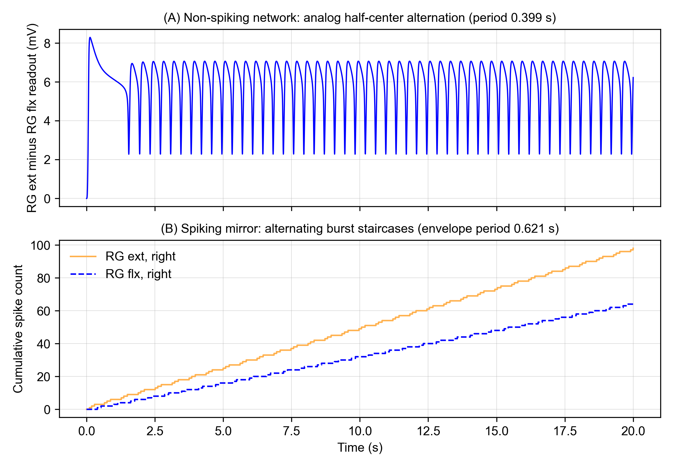
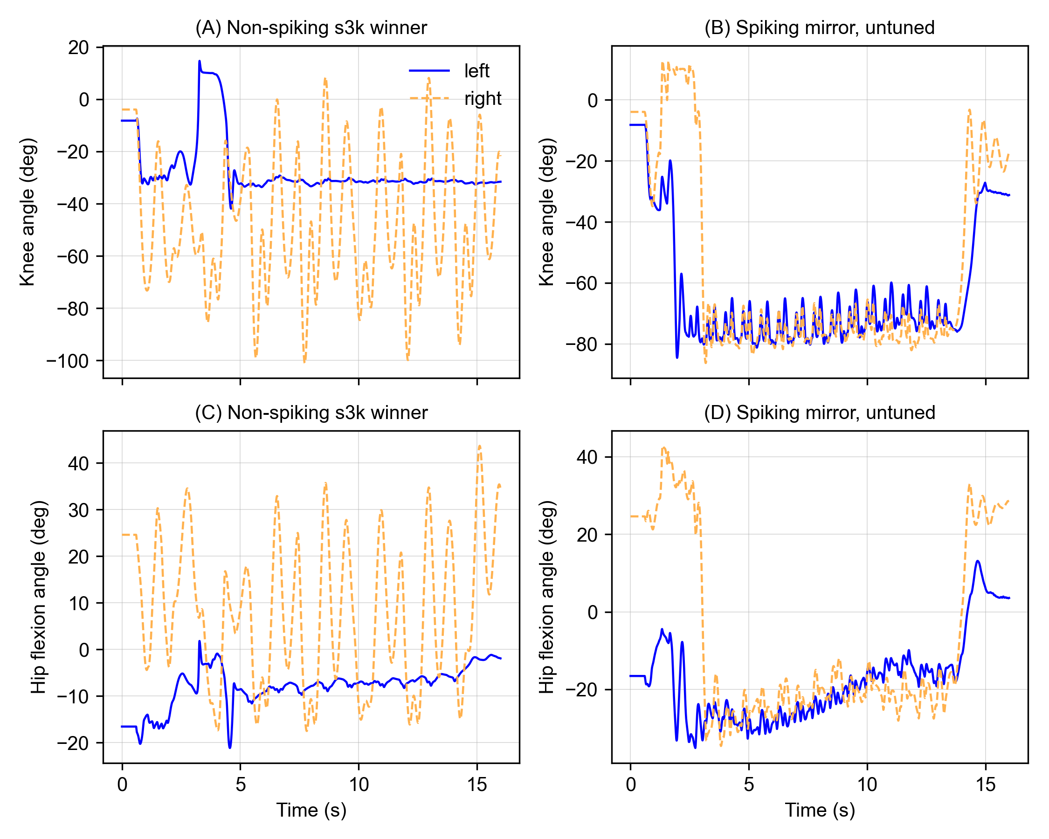
CH. 6 · SYNTHETIC NERVOUS SYSTEM · CODING ASSUMPTION
Spiking mirrors of every simulation family, judged by gates — not by eyeball
constant drive, network alone: analog 0.399 s vs spiking envelope 0.621 s (+55.6%)
ground, same winner parameters: 9 / 0 cycles (left frozen) vs 8 / 9 bilateral, untuned
gates: topology identical (1,186 / 7,908 / 7,762 connections) · basin 12/12 under 1% jitter (0.89× swing) · rhythm missed: +55.6% > 20% · air ≈10× the 0.47 Hz twin
one lead, honestly labeled: untuned mirror −236.35 vs −161.57, knee −79.8° vs −64.3° — bilateral where its twin freezes (single run, no statistics)
Dissertation Ch. 6 §Spiking-Neuron Mirror Results (gated verification campaign; motor neurons stay non-spiking by design)
37
Notes:
Evidence detail: the non-spiking baselines were re-established first - all three production configurations reproduce their documented scores exactly, including minus 161.56754173676563 for the default build, and after the mirror's selector was added the defaults gate of 410 populations, 376 inputs, and 1186 connections reproduces digit for digit (Ch. 6, line 232). The topology gate passes exactly under three gain configurations (lines 234). Spikes onto the non-spiking motor neurons are calibrated by mean conductance with residuals at or below 3e-4 mV (line 121). The untuned ground gait is a single run with no statistics, claimed only as a lead for the tuning campaign (line 246). Anticipated question: why does the 55.6% slower rhythm not doom spiking? Answer: the campaign traced the period to two identifiable knobs - the threshold-increment magnitude and the adaptation time constant - so a period-matched spiking controller is a short tuning campaign away, and the mapped parameters are the correct starting point (line 355).

Slide 38

CH. 6 · SYNTHETIC NERVOUS SYSTEM · CODING ASSUMPTION
Spiking changes timing and robustness; it does not change the interface — and it forbids parameter copies
INTERFACE: UNCHANGED
knee transient identical — 15.79° at 0.05 s
TIMING: SHIFTS
rhythm 55.6% slower · air cadence ≈10× faster
ROBUSTNESS: ITS FAVOR
spiking basin 12 / 12 · analog near a bifurcation
knee-reflex twin at the matched operating point · unit check: 62 / 62 spikes, ≤11.75 µs deviation
NAIVE COPIES: FAIL
dead · latched · co-bursting
calibrate first, gate everything — synaptic strength is a rate-code quantity, never copied from the graded value
Dissertation Ch. 6 §What Spiking Changes and Does Not (knee-reflex and beverage twins; AnimatLab conversions)
38
Notes:
Evidence detail: with only the sensory interneuron layer converted, the knee-reflex transient is identical - both read 15.79 degrees at 0.05 s - the settle band moves by 0.9 degrees, and the beverage-holding reflex modulation moves by 0.02 degrees; to the musculoskeletal model a calibrated 40 Hz train and the graded voltage it replaces are the same command (Ch. 6, lines 277, 353). The AnimatLab family is the clear negative: no spiking copy preserves the rhythm, and the thresholds-only ablation isolates the synapse conversion as the change that breaks it - per-spike conductances at the graded amplitude starve or saturate the reciprocal loop, while the 2023 spiking reference works because it was tuned as a rate code from birth (lines 327, 359). Anticipated question: do the actuator and torque conclusions of Chapters 3 and 4 depend on the coding choice? Answer: no - the motor-neuron layer stays non-spiking and the spikes onto it are calibrated by mean conductance, so the continuous activation interface is unchanged by construction (line 353). Removed from slide, kept here: settle band +0.9 deg; pour-reflex modulation 5.85 vs 5.83 deg (sag 2.00 vs 7.85 without reflex); bilateral conversion latches at 442-450 Hz; reorganized copy co-bursts at 11.8 Hz (r = 1.000); thresholds-only keeps oscillating (hip -15.1 to +23.2 deg); timing traced to two knobs (threshold increment, adaptation constant); unit level: conductance transient matches the exact exponential to 6.2e-07 uS, hybrid circuit 62 / 62 spikes within 11.75 us, mean ISI within 0.19 us of the toolbox backend.

Slide 39
CH. 7 · DISCUSSION · SYNTHESIS
Each stage feeds the next: actuator → joint → balance hardware → afferent database → neuromechanical laboratory
ACTUATOR
JOINT
BALANCE
DATABASE
SNS LAB
Ch. 3
Ch. 4
hardware studies
Ch. 5
Ch. 6
F*(ε*, P*) surface, three diameter-dependent coefficients; corrects the manufacturer tool at short resting lengths
χ-corrected torque prediction; biomimetic knee meets or exceeds human isometric torque over most of the range of motion
a BPA-actuated limb holds itself upright under pseudo-vestibular IMU feedback
943-paper audited corpus; the afferent organization the controller's channels mirror
cross-engine trace r > 0.9999 · BPA walker peaks at 60% of the pressure ceiling
the missing piece for unsupported walking is balance — a network layer, not an engine feature; once it exists, the actuation margin is already there
Dissertation Ch. 7 §Synthesis (chapters 3-6 supply the links)
39
Notes:
Evidence detail: the force model supplies the actuator terms of the torque model; the torque model supplies the biomechanical model for designing joint controllers; the validated biomimetic knee shows the architecture reproduces human joint-level force capability; the database supplies the afferent organization the controller's sensory channels mirror; and the simulation framework joins the converted model to a synthetic nervous system so closed-loop experiments can run before hardware exists (Ch. 7, lines 10-12). The cross-engine campaign adds the design constraint that runs through the chain: an SNS must survive translation between the tools in which it is built, verified, and deployed - portable primitives, tuned in whichever engine is fastest and trusted in whichever is most physical (line 14). Anticipated question: what is the single contribution? Answer: the actuator-to-joint design chain itself - characterize the actuator, correct for transmission compliance, validate against human biomechanics, and only then close the loop with a controller (Ch. 8, line 8).

Slide 40
CH. 7 · DISCUSSION · HONEST BOUNDARIES
What these results do not claim
Static, isometric models
hysteresis and dynamics set aside by design (Ch. 3)
Stiffness pair not unique
a family fits; the adopted pair fixed externally (Ch. 4)
Bio-extensor prediction still high
FVU 4.49 → 0.67 — still above measurement (Ch. 4)
Full-body co-simulation blocked
non-finite leg-joint states (Ch. 6)
No unsupported ground walking
walkers stand or latch; balance layer absent (Ch. 6)
Tuning transfers poorly
library scores 1–2 orders worse than tuning refs (Ch. 6)
and the database is deeper than broad: the afferent classification covers 86 of 561 retained papers (Ch. 5)
Dissertation Ch. 7 + chapter-level limitations (Chs. 3-6)
40
Notes:
These are stated by the dissertation itself. Actuator level: the models are static and isometric - hysteresis, thermodynamics, and airflow are deliberately set aside (a static model suffices for real-time control; dynamics come from the Elzein state-space model), and maximum contraction is not predictable a priori, so it is measured per actuator (Ch. 3, lines 318, 397; Ch. 7, line 6). Joint level: the pinned-flexor data admit a family of stiffness pairs - the adopted pair was fixed by an external requirement, not by the fit alone - and on the biomimetic extensor test the corrected prediction still sits above the measurements (FVU 4.49 to 0.67, RMSE 3.03 to 1.17 N m) (Ch. 4, lines 488, 502). Neural level: full-body co-simulation is blocked by non-finite leg-joint states; the archived walkers do not walk unsupported; tuned networks transfer poorly to diverse reference cycles; and the motoneuron-level deletion phenomena of the reference models are not yet reproduced (Ch. 6, lines 73, 165, 187, 363). The database is deeper than it is broad: the afferent classification covers 86 of 561 retained papers (Ch. 5, line 87). Anticipated question: which boundary worries you most? Answer: the balance layer - everything else is engineering.

Slide 41
CH. 7 · DISCUSSION · FUTURE WORK
The program the tools define: close the loop, extend the sensorium, build the robot, then maneuver
1 · CLOSE THE LOOP
resolve the leg-joint blocker · staged validation → full Ia / Ib / II
2 · SENSORIUM
vestibular (IMU) · ocular drift reset · cerebellar gateway
3 · PHYSICAL REALIZATION
treadmill biped · Teensy + Jetson · Ch. 3-4 models on board
4 · WHOLE-BODY MANEUVERS
gait transitions · reactive balance · the kickflip
a robot whose nervous system — unlike a living animal's — can be instrumented, stimulated, and lesioned at will
the intended demonstration: walking with human-like biomechanics under a biologically grounded neural controller
Dissertation Ch. 7 §Future Work (closing the loop in simulation; sensorium, physical realization, whole-body maneuvers)
41
Notes:
Evidence detail: the nearest work is the closed loop itself - much of the pipeline is already in place and the remaining blocker is the non-finite leg-joint states, with the foot-contact meshes the primary suspect; once resolved, staged validation runs open-loop mechanics first, then a minimal sensor set (contact plus one proprioceptive channel), then the full Ia/Ib/II set, and only then tuning across walking speeds (Ch. 7, lines 20, 24). The sensorium adds vestibular (IMU) feedback, ocular feedback as a low-frequency correction to the vestibular estimate, and a cerebellar gateway between commands and the CPG (line 45). Hardware: Teensy microcontrollers for the per-joint loops, a Jetson-class companion for network evaluation, the static models as feedforward lookup, and the Elzein pulse-modulated pressure dynamics (lines 47, 49). Anticipated question: what is first? Answer: the closed loop - the pipeline is assembled and the blocker is specific.

Slide 42
Acknowledgments
ADVISOR
M. Anthony Hunt
COMMITTEE
thank you for reading, commenting, and being here
COLLABORATORS
M. Elzein · L. Pang · L. Burgess · C. Morrow · J. Scharzenberger · C. Steele · J. Chung
LAB & SUPPORT
Agile & Adaptive Robotics Laboratory · Portland State University · NeuroNex community
42
Notes:
Keep brief; thank by name. Committee members read the dissertation in full during the revision campaign - say so.

Slide 43
Thank you — questions?
Movement and Control of Biomimetic Humanoid Robots
Ben P. Bolen · bbolen83@gmail.com
Appendix: model details, protocol, robustness checks
Notes:
Anticipated questions route to the appendix: force-model coefficients and GoF decomposition (Appendices A-C), bracket geometry and adopted χ values (Appendix H), campaign protocol and route provenance (Appendix F), and the spiking calibration and AnimatLab conversion catalogues (Appendix J).

Slide 44
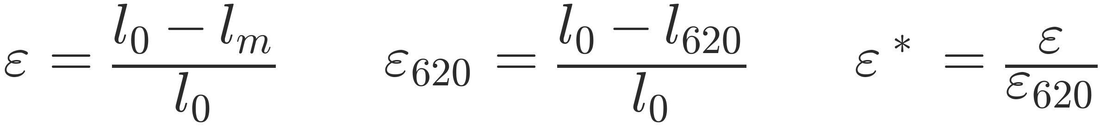
APPENDIX A · MODEL
The complete actuator force model
STRAIN MEASURES · EQ. (3.1)
NORMALIZED SURFACE · EQ. (3.4)
MAXIMUM FORCE (GENERAL P) · EQ. (3.5)
ISOMETRIC FORCE · EQ. (3.6)
Dissertation Ch. 3, Eqs. (3.1), (3.4)–(3.6); reference implementation: App. A §A.3 (Functions/f_festo.m, maxBPAforce.m)
44
Notes:
Reference card for the actuator force model of Chapter 3 (muscles). Chain: strain (3.1) normalized by the recorded free-load contraction (3.2)-(3.3); the F* surface (3.4) is fitted per diameter; F620 (3.5) carries the resting-length dependence; the product (3.6) is isometric force. Anticipated question: why can F* be clamped to zero? Answer: the zero-clamp is applied by the callers (e.g. festo4.m line 35), not inside f_festo.m itself - documented in App. A sect. A.3.

Slide 45
APPENDIX B · COEFFICIENTS
Coefficient values with 95% confidence intervals
F₆₂₀ arctan fits
b₁ (N)
b₂ (1/m)
adj. R²
RMSE (N)
ALSO ON RECORD
F₆₂₀ arctan fits, RMSE vs the Festo tool: 189.9 N (10 mm) and 668.4 N (20 mm); the tool cannot track resting length.
A 40 mm fit exists in code (c₀ 0.1224, c₁ 10.47, c₂ 2.023) but is unused in the dissertation.
⌀10 mm
303.5 (300, 308)
19.03 (17.48, 20.57)
0.9854
14.72
⌀20 mm
922.4 (914.2, 930.7)
15.37 (14.75, 15.98)
0.9945
23.83
F* surface coefficients
c₀
c₁
c₂
R² fit / val.
⌀10 mm
0.5682
4.254
0.5597
0.9998 / 0.9994
⌀20 mm
0.2579
6.477
1.321
0.992 / 0.9943
Ch. 3 Tables 3.1–3.2 (published as Bolen et al. 2026, Actuators, Tables 1–2); fitting: App. A §A.3
45
Notes:
Coefficients of record. Fitted with fittype nonlinear least squares + least-absolute-residual robustness, lower bounds [0,0,0] (App. A sect. A.3, bpaFits.m). The 40 mm fit exists in code but is unused in the dissertation. Anticipated question: how tight are the CIs? Answer: b1 for the 10 mm actuator is 303.5 N with CI (300, 308) - roughly 1.3% of the value; c0 for the 10 mm surface is 0.5682 with CI (0.5584, 0.578).

Slide 46
APPENDIX C · COMPARISON
Full goodness-of-fit against published BPA models
Bolen RMSE
FVU
max
Sárosi RMSE
FVU
max
M&B RMSE
FVU
max
⌀10 · 257 mm
22.9
0.04
46.0
143.8
1.39
235.8
73.8
0.37
122.9
⌀10 · 233 mm
16.8
0.02
30.3
132.7
1.17
222.6
62.6
0.26
101.2
⌀20 · 300 mm
35.6
0.01
114.0
132.1
0.20
313.4
72.8
0.06
137.8
⌀20 · 450 mm
67.6
0.03
166.6
177.7
0.18
294.8
862.1
4.20
1321.1
Takeaway: fixed-parameter models fail when moved off their fit length;
the normalized fit holds across lengths because each muscle carries its own F₆₂₀ and ε₆₂₀.
Ch. 3 Table 3.3; RMSE / max error in N; FVU = fraction of variance unexplained
46
Notes:
Comparison of record against Sarosi and Martens-and-Boblan. Fixed-parameter models degrade when moved off their fit length; Martens-Boblan starts to predict negative force at the 20 mm, 450 mm point. Anticipated question: why does Sarosi fail here? Answer: its parameters are length-specific (200 mm and 400 mm for the 20 mm actuator), and applying them at our 300 mm and 450 mm data over-predicts force at higher pressures and low contraction (Ch. 3, model-comparison discussion).

Slide 47
APPENDIX D · COMPLIANCE CHAIN
From bracket stiffness matrix to solved deflection
1 · project compliance on the force direction · eq. (4.18)
2 · add artificial tendon in series · eq. (4.20)
3 · solve the force balance, then propagate · eq. (4.22)
δ from F₆₂₀·F*(ε*(δ), P*) − k_eq·δ = 0 (fzero, bracket [0, lₘ − l₆₂₀]; δ ≡ 0 if uncorrected ε* > 1)
then vector deflection → attachment moves → path length, force direction, moment arm, torque recomputed
two-BPA flexor grouping: coupled balance shares one common force, solved on [0, F₆₂₀]
Ch. 4 Eqs. (4.18), (4.20), (4.22); implementation: App. A §A.5; frames and arrays: App. C §§C.3–C.4
47
Notes:
One-dimensional nonlinear root-find per configuration: fzero on [0, l_m - l_620], converged to machine precision by bracket collapse; safeguards return delta = 0 at saturated strain or when no sign change appears (App. A sect. A.5). Anticipated question: is the series reduction exact? Answer: only under the stated conditions - both elements carry the same force, displacements add kinematically along the line of action, u-hat is fixed within one iteration then updated, elements are linear and moment-free - each condition is listed in Ch. 4 (Improved Torque Model).

Slide 48
APPENDIX E · WRAP LOSS
Wrapping-loss implementation, per contact arc
PINNED EXTENSOR
two physical contact arcs:
R₁ = 12 mm from 27° to −23°
R₂ = 40 mm on the second bracket
arc-length normalizers: 27.75/(ang₁−ang₂), 92.46/(ang₂+120°)
BIOMIMETIC CONFIGURATIONS
Δl = χ₃ · b(θₖ) · (1 − ε*)²
b(θₖ) = routed bend measure (arc length swept by the wrap)
w Rap = 25 mm bend radius in the route builder
Applied to the force-producing strain only
the kinematic strain that predicts muscle length excludes Δl; the loss changes force, not recorded geometry.
Ch. 4 Eqs. (4.24)–(4.26); implementation: App. A §A.6 (minimizeExtX3.m, Contraction); constants: App. C §C.4
48
Notes:
The loss enters only the force-producing strain; the kinematic (prediction) strain excludes it. Anticipated question: is the loss double-counted? Answer: no - the kinematic strain that predicts muscle length excludes delta-l, so the loss changes force, not recorded geometry (App. A sect. A.6).

Slide 49
APPENDIX F · PROTOCOL
Identification campaign details and data decisions
Encoder correction
the 47.9 cm flexor test’s measured angles carry a +5.3° correction at load time (App. C, Table C-1); it was not used in the identification, and its corrected-model fit is a post hoc evaluation
Training / validation
flexor: four tests cross-validated, 2 training / 2 held-out per fold (adopted fold: 48.5 + 41.0 cm train, 45.7 + 40.6-tendon validate) · extensor: training {43, 43-tendon, 46 cm}, validation {40, 40-tendon, 47 cm}; 42, 42-tendon, and 48 cm not used
Non-uniqueness handled explicitly
a family of stiffness pairs fits the training tests nearly equally well; the adopted pair (pooled-front row 77; extensor locked refit row 32) is the one for which both redesigns meet the required 5% overshoot simultaneously (+5.01% flexor, +5.02% extensor)
Solver settings of record
NSGA-II gamultiobj · flexor: population 150, ≤600 generations, spread tol 4×10⁻³ · extensor: population 50, ≤150 generations, 10⁻³ · offsets searched in cm, stiffnesses on log₁₀
Ch. 4 §4.1 (identification); test constants: App. C §C.1; bounds and adopted values: App. C §§C.4–C.5
49
Notes:
Protocol of record. Data rulings: the +5.3 degree encoder correction on the 47.9 cm flexor test (applied to experimental angles at load time), and the three extensor tests not used in the evaluation (3, 4, and 9). The stiffness pair is not unique - the adopted pair is the one for which both redesign configurations meet the required 5 percent overshoot simultaneously. Anticipated question: why gamultiobj? Answer: the Pareto front is required for holdout validation; settings of record - flexor: population 150, up to 600 generations, spread tolerance 4e-3; extensor: population 50, up to 150 generations, 1e-3.

Slide 50
APPENDIX G · INVARIANCE
Frame convention is irrelevant for y-symmetric stiffness arrays
CLAIM (CH. 4, IMPROVED TORQUE MODEL)
Let K = diag(a, b, a); equal stiffness about x and z. For any frame whose second rotation is about y, the projected scalar stiffness
k(û) = (ûᵀ K⁻¹ û)⁻¹
is unchanged: the rotation about y mixes only the two coordinates with equal compliance, and the two frame conventions produce identical torque predictions to numerical precision.
Invariant if and only if the x- and z-axis stiffnesses are equal; the proof is the rotation identity Ry(θ)·K·Ry(θ)ᵀ = K with Ry a rotation about y.
SCOPE
Holds for y-symmetric arrays only.
The extensor’s arch bracket is not y-symmetric: the bracket forms an arch extending 75 mm in the Z direction, so χ₂ sits along the bracket x axis and χ₁ along y and z; an assignment carried on physical grounds, not derived from this proof.
Ch. 4 §4.1 (Improved Torque Model); bracket frames and arrays: App. C §§C.3–C.4
50
Notes:
Frame-convention invariance, proven in Ch. 4: a diagonal stiffness array is invariant under a rotation about y if and only if the two stiffnesses in the rotation plane are equal (k_x = k_z); with the y-symmetric array the pitch-only and two-rotation conventions give identical torque predictions to numerical precision. Anticipated question: where does this not apply? Answer: non-symmetric axis assignments - the extensor arch bracket sets chi-2 in X_br and chi-1 in Y_br/Z_br on physical grounds (the arch extends 75 mm in Z), a modeling choice carried, not derived.

Slide 51
APPENDIX H · BRACKET DATA
Bracket reference points and adopted correction terms; recorded together
Bracket reference points (mm)
Adopted correction terms
point
x, y, z
configuration / meaning
χ₀ (mm)
χ₁ (N/m)
χ₂ (N/m)
χ₃
Pbri
−48.11, −107.81, 13.80
pinned flexor · insertion bracket (ICR frame)
Flexor
+3.94
3.998e4
1.473e4
—
Pbr2
−52.61, 0, 75.06
pinned flexor · origin 2nd bracket (hip frame)
Extensor
−6.38
locked
locked
0.158
Pbr
−3.84, −46.44, 62.50
pinned extensor · rib midpoint (hip frame)
extensor refit locks (χ₁, χ₂) to the flexor pair and solves only (χ₀, χ₃); one stiffness pair across all configurations
Pbr
8.38, 20.75, 25.10
biomimetic extensor 10 mm · cantilever
Pbr
9.48, −33.38, 33.90
biomimetic flexor 20 mm · bolt-pattern centroid
Pbr
−19.00, 22.00, 27.60
biomimetic flexor 10 mm · cantilever centroid
Moving a reference point changes the identified stiffness; App. C records each point alongside the values it produced.
Adoption provenance: flexor pooled-front row 77 (212 members) · extensor locked refit row 32 (only χ₀, χ₃ searched).
Reference points: App. C §C.3 (Table C-5); adopted values and provenance: App. C §C.5 (Table C-8)
51
Notes:
Bracket data of record. Moving a reference point changes the identified stiffness values, so Appendix C records each point alongside the values it produced. Provenance: flexor values are pooled-front row 77 of the two-bracket CV (212 members); the extensor refit locked the pair and solved only (chi-0, chi-3) - flxr77 row 32. The pre-freeze lab study that compared the rib midpoint against the lower bolt hole is not part of the dissertation and is not shown. Anticipated question: how sensitive is the identification to the point choice? Answer: within the dissertation the points are fixed CAD interpretation choices recorded with the values they produced; the explicit sensitivity comparison predates the freeze.

Slide 52
APPENDIX I · KINEMATICS
Moment arm and torque conventions
CONVENTIONS
r = perpendicular foot of the joint origin onto the line of action; identical result to the cross-product projection of Eq. (4.2)
scalar moment arm rₖ = hypot(in-plane components) in the tibial body frame, about the knee z-axis
torque evaluated only in tension (entries discarded for ε < −0.02, the excessive-stretch region)
human targets: OpenSim derivative arms r(θₖ) = ∂l_MT/∂θₖ across the RoM, multiplied by maximum isometric force
Ch. 4 Eqs. (4.1)–(4.2); implementation: App. A §A.4 (MonoPamDataExplicit.m lines 156–168, 308); human targets: App. A §A.1
52
Notes:
Moment-arm conventions. The robot side uses the perpendicular-foot construction of App. A sect. A.4; the human targets are computed in OpenSim with the derivative definition r(theta_k) = d(l_MT)/d(theta_k) across the range of motion (App. A sect. A.1). Anticipated question: are the two equivalent? Answer: yes for a straight muscle path crossing a planar revolute joint; the derivative form remains correct for wrapping and moving-path-point geometry, which is why the human targets are computed in OpenSim rather than by the robot-side construction.

Slide 53
APPENDIX J · IMPLEMENTATION
Synthetic nervous system: Simulink library and spiking twin
seven core masked blocks (library grows to 12, then 15 with the spiking additions); runs in base Simulink
knee-reflex spiking twin at the matched operating point: transient identical (15.79° at 0.05 s), settle +0.9°
CAD COUPLING (CH. 6 §6.2)
SolidWorks → URDF → Simscape Multibody import verified on a trial knee assembly; tendon hardware modeled in CAD, not yet inserted.
SPIKING BLOCK VERIFICATION (CH. 6 §6.4)
single-spike conductance to 6.2×10⁻⁷ µS · 62/62 spikes vs the toolbox equations · committed regression exact (6.07×10⁻⁴ mV).
Ch. 6 §6.2 (Figs. 6.5 and 6.11); spiking-twin numbers: Ch. 6 Table 6.4; neuron and synapse equations: App. B §§B.1–B.4
53
Notes:
Two parallel implementations: AnimatLab (prototyping and the archived reference models) and Simulink/MuJoCo (the pipeline). The Simulink library runs in base Simulink without extra toolboxes: seven core blocks, twelve before the spiking additions, fifteen after (Ch. 6 sect. 6.2). The spiking twin of the knee-reflex demonstration replaces only the sensory interneuron layer: transient identical (15.79 deg at 0.05 s in both), settle band +0.9 deg (Table 6.4). CAD coupling verified via SolidWorks-URDF-Simscape on a trial knee assembly; tendon hardware modeled in CAD, not yet inserted. Anticipated question: why maintain Simulink alongside MuJoCo? Answer: a standard controls-engineering environment for inspection and the hardware-transfer path, with unit-verified spiking blocks - single-spike conductance transient to 6.2e-07 uS, 62/62 spikes against the toolbox equations, and every committed demonstration reproducing exactly (two-neuron units test 6.07e-04 mV).

Slide 54
APPENDIX K · WALKER NUMBERS
Walker configurations of record: scores, library sweep, and pathway deletions
Gait-validation sweep (43-reference library)
Pathway deletions, s3k (tuning-reference score)
config
tuning-ref
library mean
removed pathway
score
none (full model)
−186.4
s3k
−186.4
−8776
Ia afferents
−25 (no cycles)
s3kpruned
−176.1
−6924
all afferent classes
−267.8
syn6
−200.4
−9961
Renshaw cells
−267.3
w2lvar
−144.5
−5808
group-II afferents
−255.2
most negative reference: Case_40_motion for s3k (−8841), s3kpruned (−6986), and syn6 (−10040); subject08_Run_20002 for w2lvar (−5896)
Ib afferents
−180.3
contact channels
−183.9
interleg commissurals
−174.9
Drive stimulus: s3k survives +0.01, −0.01, −0.02 (−201.9, −177.0, −171.2), freezes at +0.02, and never fell in 15 push evaluations (max sway 0.123 m).
syn6 and w2lvar fall under every ±0.01 / ±0.02 drive step (pelvis tilt 39–40°); s3kpruned survives −0.02 (−168.2).
Ch. 6 Table 6.1 (gait sweep) and Table 6.2 (pathway removal); drive perturbations: Ch. 6 §6.3
54
Notes:
Walker numbers of record for committee questions. Score is the cycle-shape kinematic score: 0 is perfect agreement, -25 the fixed no-cycle fallback. Library means sit one to two orders of magnitude beyond the tuning-reference scores - an honest transfer measurement, not an artifact of the 32 running trials (s3k walking-only mean -8816 vs running-only -8761). Anticipated question: which deletion matters most? Answer: removing the Ia pathway freezes the production configuration outright (no cycles detected), while the six-synergy variant keeps a bilateral gait with every afferent class removed (-190.5, ten cycles per leg, knee minimum -71.2 deg, 0.684 s period); the W2L-layout variant depends on Ia (-273.5) and on the weak rhythm-generator mutual excitation (-279.9).

